Slide 1
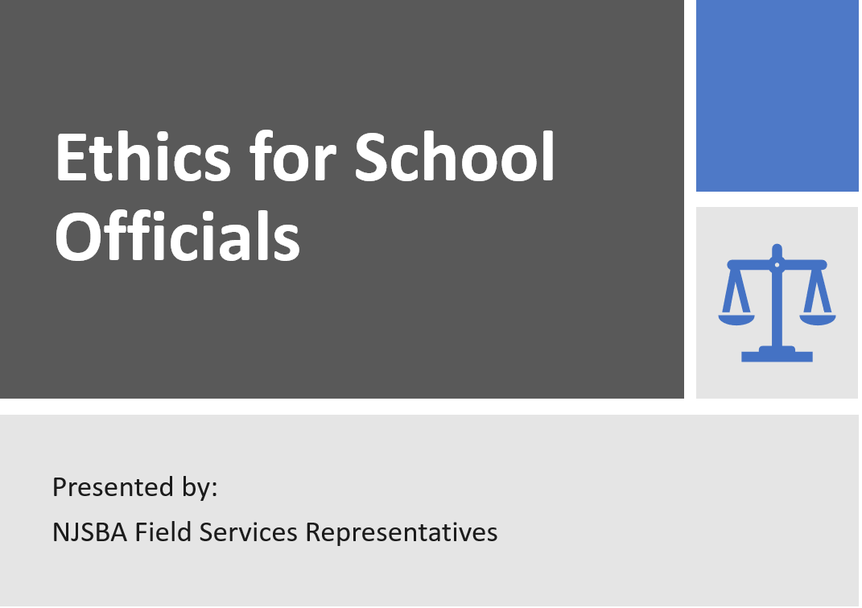

Slide 2
Disclaimer
The content discussed in this presentation is for informational purposes only and not for the purpose of providing legal advice. The application and impact of laws can vary widely based on the specific facts involved. No action should be taken in reliance on information discussed in this presentation, and the NJSBA disclaims all liability for actions or not taken based on such content to the fullest extent permitted by law.
You should contact your board/school attorney to obtain advice with respect to any issue or problem.
Important to note: Final regulations under Chapter 28 could be different than what is in the proposed language, and we are not yet sure what the effective date for the 90-day training requirement for NBMO training will be.

Slide 3
Ethics/Accountability
“Public service is about serving all the people, including the ones who are not like you.”
Constance Wu

Slide 4
School Ethics Act N.J.S.A. 18A 12-21 (1991)
It is essential that the conduct of members of local boards of education and local administrators hold the respect and confidence of the people.
These board members and administrators must avoid conduct which is in violation of their public trust or which creates a justifiable impression among the public that such trust is being violated.

Slide 5
Who is Accountable?
Conflicts of Interest
Disclosure Statements
Provisions Apply to all School Officials:
Board members/charter school trustees
NJSBA staff/officers
Administrators
-Holds certificate to serve as School Administrator, Principal, or Business Administrator
-Holds a position that is responsible for making recommendations regarding hiring or the purchase/acquisition of property and services. (Either no certification or supervisor certification)
Code of Ethics
Mandatory Training
Provisions Apply to:
Board members/charter school trustees only.

Slide 6
School Ethics Act

Slide 7
Code of Ethics for School Board Members Only N.J.S.A. 18A:12-24.1, N.J.A.C. 6A:28-6.4(a)(1)
I will uphold and enforce all laws, rules and regulations of the State Board of Education, and court orders pertaining to schools. Desired changes shall be brought about only through legal and ethical procedures.
a.
Standards
Factual evidence shall include a copy of a final decision from any court of law or administrative agency of this State demonstrating that the respondent(s) failed to enforce all laws, rules and regulations of the State Board of Education, and/or court orders pertaining to schools or that the respondent brought about changes through illegal or unethical procedures.

Slide 8
Code of Ethics (continued)
I will make decisions in terms of the educational welfare of children and will seek to develop and maintain public schools that meet the individual needs of all children regardless of their ability, race, creed, sex, or social standing.
b.
Standards
A decision was willfully made contrary to the educational welfare of children, or deliberate action was taken to obstruct the programs and policies designed to meet the individual needs of all children, regardless of their ability, race, color, creed or social standing.

Slide 9
Code of Ethics (continued)
I will confine my board action to policy making, planning, and appraisal, and I will help to frame policies and plans only after the board has consulted those who will be affected by them.
c.
Standards
Board action was taken to effectuate policies and plans without consulting those affected by such policies and plans, or action was taken that was unrelated to the respondent's duty to: i. Develop the general rules and principles that guide the management of the school district or charter school; ii. Formulate the programs and methods to effectuate the goals of the school district or charter school; or iii. Ascertain the value or liability of a policy.

Slide 10
Code of Ethics (continued)
I will carry out my responsibility, not to administer the schools, but, together with my fellow board members, to see that they are well run.
d.
Standards
A direct order was given to school personnel or there was direct involvement in activities or functions that are the responsibility of school personnel or the day-to-day administration of the school district or charter school.

Slide 11
Code of Ethics (continued)
I will recognize that authority rests with the board of education and will make no personal promises nor take any private action that may compromise the board.
e.
Standards
Personal promises were made, or action taken beyond the scope of his or her duties such that, by its nature, had the potential to compromise the Board.

Slide 12
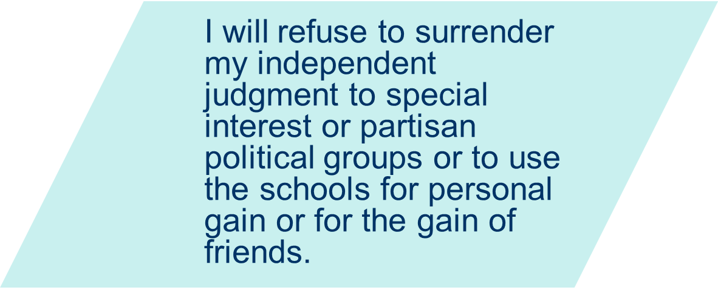
Code of Ethics (continued)
f.
Standards
Action was taken on behalf of, or at the request of, a special interest group or persons organized and voluntarily united in opinion and who adhere to a particular political party or cause; or the schools were used in order to acquire some benefit for the respondent(s), a member of his or her immediate family or a friend.

Slide 13
Code of Ethics (continued)
I will hold confidential all matters pertaining to the schools which, if disclosed, would needlessly injure individuals or the schools. In all other matters, I will provide accurate information and, in concert with my fellow board members, interpret to the staff the aspirations of the community for its school.
g.
Standards
Took action to make public, reveal or disclose information that was not public under any laws, regulations or court orders of this State, or information that was otherwise confidential in accordance with board policies, procedures or practices. Inaccuracy of information and evidence that establishes that the inaccuracy was other than reasonable mistake or personal opinion or was not attributable to developing circumstances must be substantiated.

Slide 14
Code of Ethics (continued)
I will vote to appoint the best qualified personnel available after consideration of the recommendation of the chief administrative officer.
h.
Standards
A personnel matter was acted upon without a recommendation of the chief administrative officer.

Slide 15
Code of Ethics (continued)
I will support and protect school personnel in proper performance of their duties.
i.
Standards
Deliberate action was taken which resulted in undermining, opposing, compromising or harming school personnel in the proper performance of their duties.

Slide 16
Code of Ethics (continued)
I will refer all complaints to the chief administrative officer and will act on the complaints at public meetings only after failure of an administrative solution.
j.
Standards
Acted on or attempted to resolve a complaint, or conducted an investigation or inquiry related to a complaint: i. Prior to referral to the chief administrative officer; or ii. At a time or place other than a public meeting and prior to the failure of an administrative solution.

Slide 17
2022 Commissioner/SEC Decisions
Related to the Code of Ethics

Slide 18
2022 Commissioner/SEC Decisions
Related to the Code of Ethics

Slide 19
What is a Conflict of Interest? N.J.S.A. 18A12-24
 | Recuse yourself if there is a benefit to you (school official) or your immediate family due to:
a. | Business interest or professional activity in conflict.
b. | Use of position to secure unwarranted privileges, advantages or employment. Extends to “others” so may go beyond definition of immediate family.
c. | Financial involvement that may impair objectivity
d. | Service or employment that may prejudice independent judgement
e. | Gift, favor, etc. offered with intent to influence
f. | Financial gain
 | Other Considerations:
g. | Shall not represent any person/party other than Board/district in matter before the Board.
h. | Not a conflict if not accruing a greater gain than any others.
i,j,k | (See N.J.S.A. 18A:12-24)

Slide 20
Relationship Definitions
Immediate Family Member
Dependent Child
Relative
Current
Definitions
N.J.S.A.
18A:12-23
Spouse or dependent child residing in the same household
Any child claimed as a dependent on federal and state tax returns
Spouse, natural or adopted child, parent, or sibling
Spouse, civil union partner, domestic partner, or dependent child residing in the same household
Any child claimed as a dependent on federal or state tax returns
Spouse, civil union/domestic partner or parent, child, sibling, aunt, uncle, niece, nephew, grandparent, grandchild, son/ daughter-in-law, stepparent, stepchild, stepbrother/sister half-brother/sister of the individual or the individual's spouse, civil union/domestic partner, by blood, marriage, or adoption. (Nepotism law)
Relationships that may cause a conflict
Chapter 28
Regulations - Proposed
Definitions

Slide 21
Hiring/Personnel
May not hire a relative of a board member or chief school administrator.
(May be exceptions)
If the relative already works in the district:
An administrator may not exercise direct or indirect authority over a relative of the administrator.
A board member may not take part in employment matters concerning the CSA or supervisors in the chain of command between the relative and the CSA.
A board member may not take part in the search, selection, or vote to hire a new CSA, and post-hire evaluations and contract discussions.
NO - Discussion
- Vote
taking part in:

Slide 22
Collective Bargaining A24-17
Relationship to Board Member | Current Member of a Statewide Public Teachers’ Union | Participate in Negotiations Yes or No | Vote to Ratify the Contract Yes or No
Spouse Dependent Child Child (not dependent) Relative | Works in the District | No | No
Self Spouse Dependent Child | Works Out-of-District | No | Yes* **
Child (not dependent) Relative | Works Out-of-District | Yes* | Yes*
* Absent another conflict
** After Memorandum of Agreement, salary guides, total compensation package attained.

Slide 23
Collective Bargaining
Other possible conflicts:

Slide 24
2022 Commissioner/SEC Decisions
Related to Conflicts of Interest

Slide 25
2022 Commissioner/SEC Decisions
Related to Conflicts of Interest

Slide 26
Public Advisory Opinions (2022 opinion and 2021 opinions released in 2022)
Public Advisory Opinions A03-22, A219-21
Board member is full-time bus driver in another district. Does not pay dues to the local NJEA-affiliated local education association but the employment terms are governed by the bargaining agreement. Can they participate in negotiations as a Board member if the district’s association is also affiliated with the NJEA?
Board vote on superintendent merit goals failed. 2 members could not participate because their spouses work in the district. Superintendent resigned. If the Board revotes on these merit goals, can these 2 members participate since the former superintendent is no longer an employee?
No. Since both districts local education associations are affiliated with the NJEA, the Board member is precluded from being involved in all aspects of negotiations until the total compensation package has been determined. Absent other conflicts, may vote on the final contract. (A03-22)
No. The same conflict of any and all matters related to the superintendent continue to apply to the former superintendent despite the fact he no longer works for the district. (A19-21)

Slide 27
Public Advisory Opinions (2021 opinions released in 2022)
Public Advisory Opinions A16-21, A20-21
Board member’s ex-spouse works in district and is member of local education association (LEA). Have custody and child/ spousal support agreements. Ex-spouse not considered relative or immediate family member based on SEC definitions. Is the Board member conflicted from matters regarding the superintendent, LEA, and other administrators in the chain of command? | Yes. It could reasonably be perceived that an indirect personal or financial involvement exists that may impact objectivity and may yield unwarranted privileges/advantages to ex-spouse. Ex-spouse is “other” in SEC definitions. Absent other conflicts, can vote on final contract with LEA. (A16-21)
Board member’s aunt-in-law (spouse of spouse’s uncle) and another board member’s distant cousin work in district. Can these board members participate in labor negotiations with the LEA and matters related to the superintendent? | These relationships are not an automatic conflict, but the Board members must be sure not to extend unwarranted privileges, advantages, or employment to “others.” Absent other conflicts, these members can participate. A20-21

Slide 28
Public Advisory Opinions (2021 opinions released in 2022)
Public Advisory Opinions A13-21, A12-21, A04-21, A03-21
In 4 separate opinions, Board members either work or volunteer in organizations that interface with school districts: Work as public-facing community liaison to forge links between employer and community/schools Sales and marketing representative for platform that collects, tracks and manages student health information for school nurses. Local chapter head for national non-profit for healthy school hours. Started non-profit to help families in crisis with basic needs. | Organizations not under control of, overseen by, or otherwise managed by board/district not per se conflict. In general: Recuse from all Board discussions and votes of employer and of competing entities that offer same services. Cannot represent employer in district or rely on board membership when soliciting other groups. Should not provide any information re: non-profit or employer to the Board, district employees or families. Would violate the act if directly solicit financial contributions, donations, or supplies from District families, provide services to district families or collaborate with PTO. (A13-21, A12-21, A04-21, A03-21)

Slide 29
What Training is Mandatory? N.J.S.A. 18A:12-33
By end of: Year 1
Year 2
Year 3
Year following reelection or reappointment
Chapter 28
Regulations -
Proposed change for new Board members
only – training
completed by
first 90 days
Governance 1 (New Board Member Orientation)
Basic knowledge/skills, NJQSAC, HIB, CSA Evaluation, OPMA, Code of Ethics
NJSBA provides
this training
through multiple
options:
In-person
Live-virtual
Self-paced online
Governance 2
Finance/Labor
Governance 3
Student Achievement
Governance 4
Legal Updates

Slide 30
Disclosure Statements
Personal/Relative and Financial Disclosure Statements

Slide 31
Who Enforces the Act?
The School Ethics Commission is the body charged with enforcing the act.
N.J.S.A. 18A:12-27 (a)
9 members appointed by the governor for a 3-year term
(maximum 5 from any one political party)
2 School Administrators
2 School Board Members
5 Non-school Officials

Slide 32
SEC Jurisdiction
Advisory Opinions
N.J.S.A. 18A:12-31
Only a school official may request an advisory opinion to determine if any proposed activity or conduct by a school official in same district would constitute a violation of the Act.
Ethics Complaints
Acts upon complaints filed by anyone alleging a violation of the School Ethics Act or Code of Ethics took place.
Per SEC,
In any given year, the yearly average:
85 Ethics complaints filed
35 Advisory Opinions requested
Can be made public. Needs 6 Votes SEC.

Slide 33
Filing Considerations

Slide 34
What are the Penalties?
Violation of the Act
Censure
Reprimand
SEC may recommend to the Commissioner:
Suspension
Removal
Rebuke by Commissioner that conduct violated standards but does not result in a formal resolution.
Formal disapproval by Commissioner publicized by adoption of resolution.
Immediate termination from Board membership or employment ( if administrator).
Barred from engaging in any activity/ matter for a designated period of time.
Updated proposed definitions (Chapter 28 regulations)
SEC makes recommendation to Commissioner for final agency decision.
Appeals are heard by the Appellate Division.

Slide 35
What is the Penalty Process? Noncompliance - Training/Disclosure Statements Proposed Chapter 28 Regulations
If a member does not complete their Mandatory Training or Disclosure Statement by the required date, the SEC proposed a path that ties the penalty to the out-of-compliance completion date so it is clear up front what penalty may be expected.
The SEC will first send the out-of-compliance member an Order to Show Just Cause as an opportunity for the school official to respond why they should not be found in violation of the Act.
Censure
After Just Cause order &
Before SEC Decision
Suspension
After SEC Decision &
Removal
After Commissioner Decision
Before Commissioner Decision
Proposed penalty based on when out-of-compliance Mandatory Training or Disclosure Statement has been completed:
(Unless Just Cause is shown)

Slide 36
Volunteering in School A07-00, A32-14, A10-15, A17-15, A15-18
Serving on the Board does not prevent volunteerism in the schools, but consideration needs to be given to:
Degree of involvement with staff and students (Frequency/Level of Interaction) | Degree of authority to give and receive directions/ orders to staff and students
What is the degree of:
Giving directions or orders to staff or students
Taking orders from staff
Will I be in the building often? (“enmeshed in the building”)
Will I be handling the school district’s money?
Will I be the lead/regular volunteer or coach for a school district club, activity or sport?
Advise superintendent you will be performing this work.
Refrain from any related Board discussion or vote.
Always be cognizant of the obligations of the Act.

Slide 37
Interview Committees
Board member involvement in interviews for positions other than that of Superintendent is not encouraged. A31-15.
A04-12. Should the CSA decide to include other stakeholders in the interview process for high-level positions, it would not be a violation of the Act provided:
No more than 1 or 2 board members are included
It is coordinated by an administrator
Board participation is limited to observations/ assessments
Final recommendations are wholly within the purview of the superintendent.

Slide 38
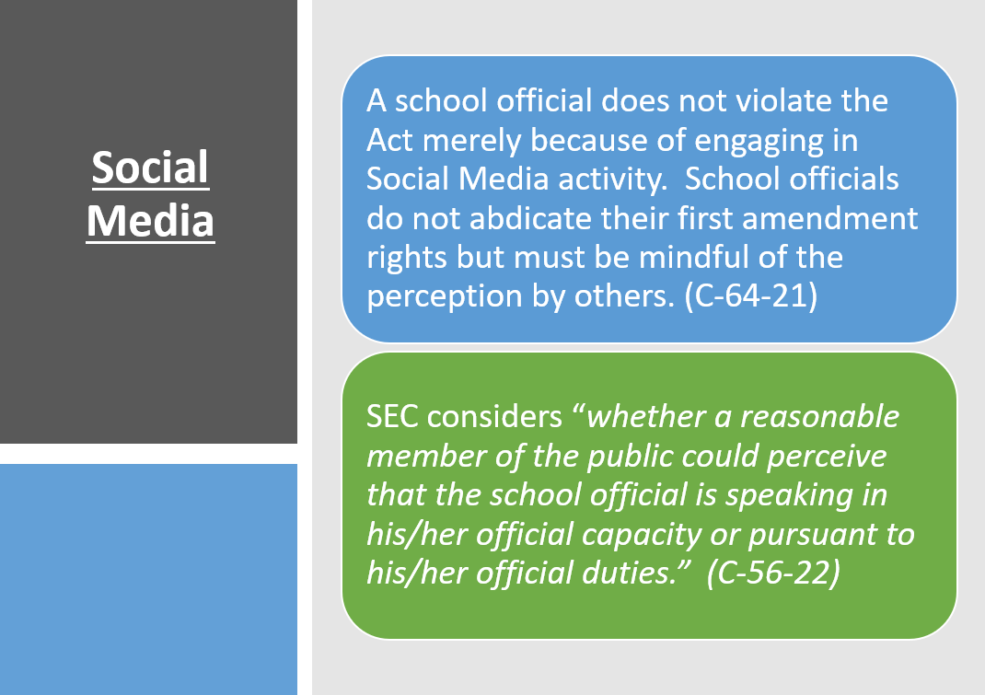
Social Media

Slide 39
Social Media

Slide 40
Social Media

Slide 41
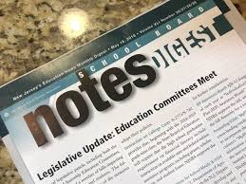
Points to Consider…
NJSBA recommends boards develop a list of board members and administrators who have a conflict and review it regularly.
Consult with your Board attorney on ethics issues and to identify conflicted members/administrators.
Continue to check School Board Notes to keep abreast of newly released advisories.

Slide 42
Ethics Reminder

Slide 43
Links for Examples Used
School Ethics Commission & Commissioner Sites:
Cases
C56-19 and 57-19 https://www.nj.gov/education/legal/commissioner/2022/aug/201-22SEC.pdf
C28-20 https://www.nj.gov/education/legal/commissioner/2022/may/105-22SEC.pdf
C71-20 https://www.nj.gov/education/legal/commissioner/2022/apr/79-22SEC.pdf
C68-20 https://www.nj.gov/education/legal/commissioner/2022/apr/78-22SEC.pdf
C67-20 https://www.nj.gov/education/legal/commissioner/2022/apr/77-22SEC.pdf
C60-19 https://www.nj.gov/education/legal/ethics/2022/docs/C60-19%20PC%20-%207-29-2022.pdf
C29-21 https://www.nj.gov/education/legal/ethics/2022/docs/C29-21%20-%20JP_et.pdf
C18-21 https://www.nj.gov/education/legal/ethics/2022/docs/C18-21%20CE%20-%20%2007-29-2022.pdf
Advisory Opinions
Link to all Advisory Opinions: https://www.nj.gov/education/legal/ethics/advisory/
Opinions related to Volunteerism: A32-14, A10-15, A17-15, A07-00, A15-18
Opinions Related to Interviews: A15-10, A04-12, A31-15
2021/22 Opinions: A03-21,A04-21,A12-21,A13-21,A16-21,A19-21,A20-21,A03-22 Union Endorsement: A10-18

