Slide 1
Superintendent’s Report State of the Schools February 20, 2024

Slide 2
Impact Employee Recognition/Student Recognition
A Small Glimpse
HIB Report for January 24, 2024 - February 13, 2024, Affirm
HIB Report for February 13, 2024 - February 20, 2024, Report
Student Liaisons – Neissa Filias & Gia Patel
Special Education Audit Presentation, Gary Molenaar from the Educational Services Commission of NJ
Annual Fiscal/Budget Audit Presentation, Suplee Clooney & Company

Slide 3
IMPACT EMPLOYEE RECOGNITION
Aims to acknowledge administrators, educators, and staff members who, through their actions, dedication, and achievements, have profoundly influenced the lives of our students.
Tanisha Royster: UHS Cosmetology Teacher

Slide 4
Tanisha Royster
Ms. Royster is a teacher & mentor who continually and profoundly impacts her students' lives. Ms. Royster continues to provide our Union High School students with real-life experiences that will continue to make our cosmetology program shine as one of the many vocational education programs we offer our TUPS students.
Ms. Royster has shown us the transformative power of mastering a craft and, more importantly, the art of nurturing talent and confidence in her students.
Beyond teaching the technical skills of cosmetology, Ms. Royster fosters an environment of creativity, self-expression, and self-assurance. Ms. Royster impacts her students' daily lives as an educator by fostering their passions to allow them to discover that their dreams will become a reality when they receive their cosmetology licenses and eventually achieve greatness.

Slide 5
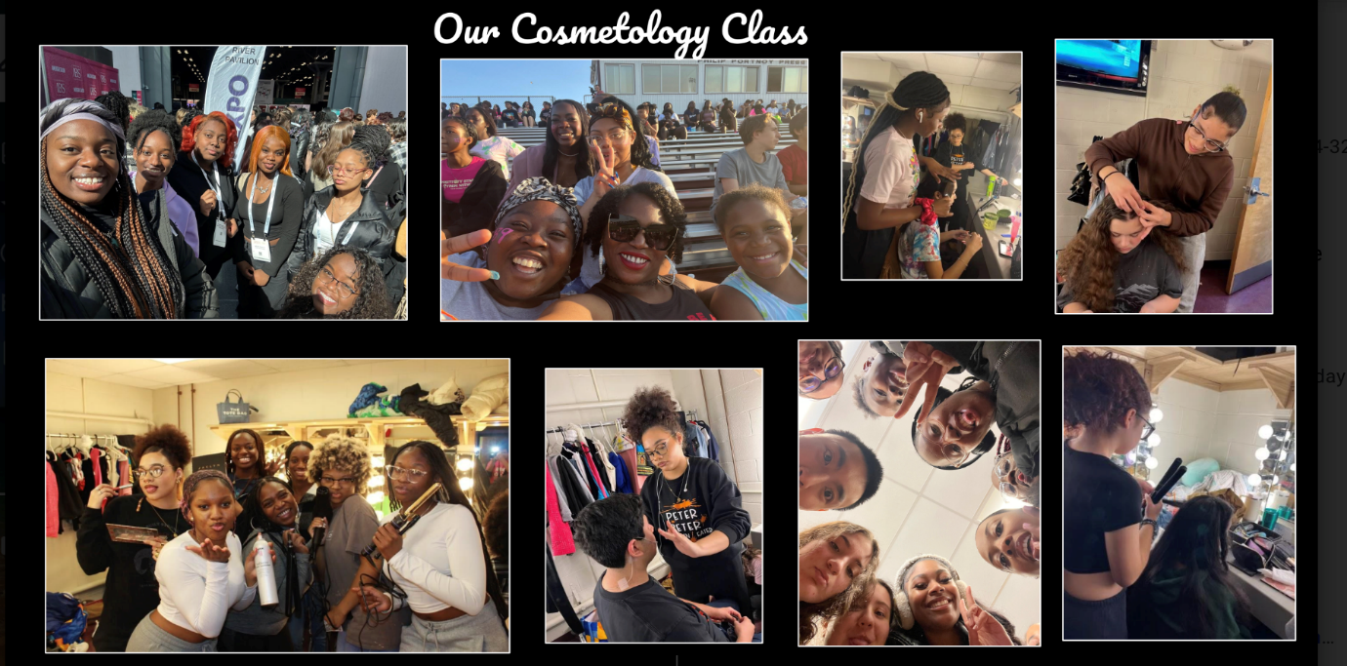

Slide 6
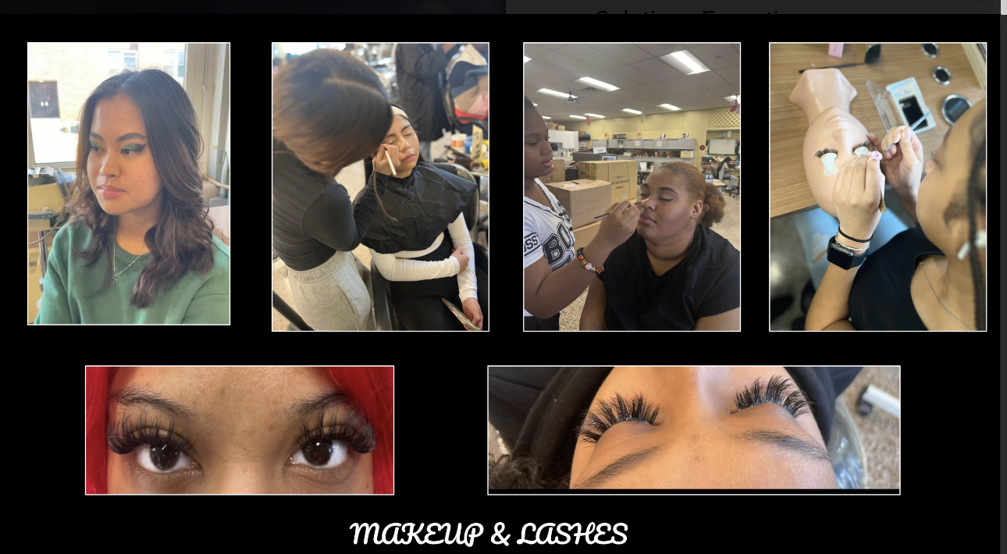
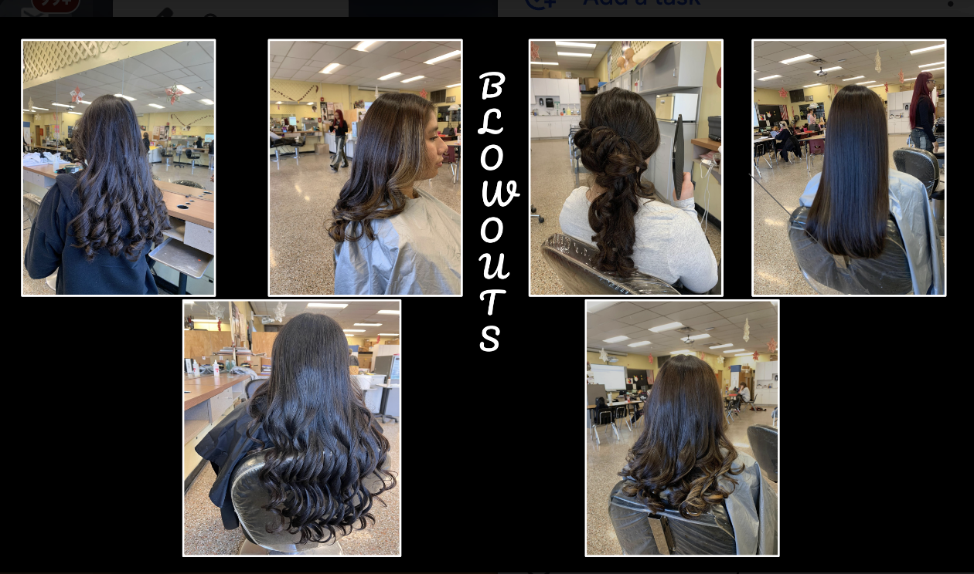
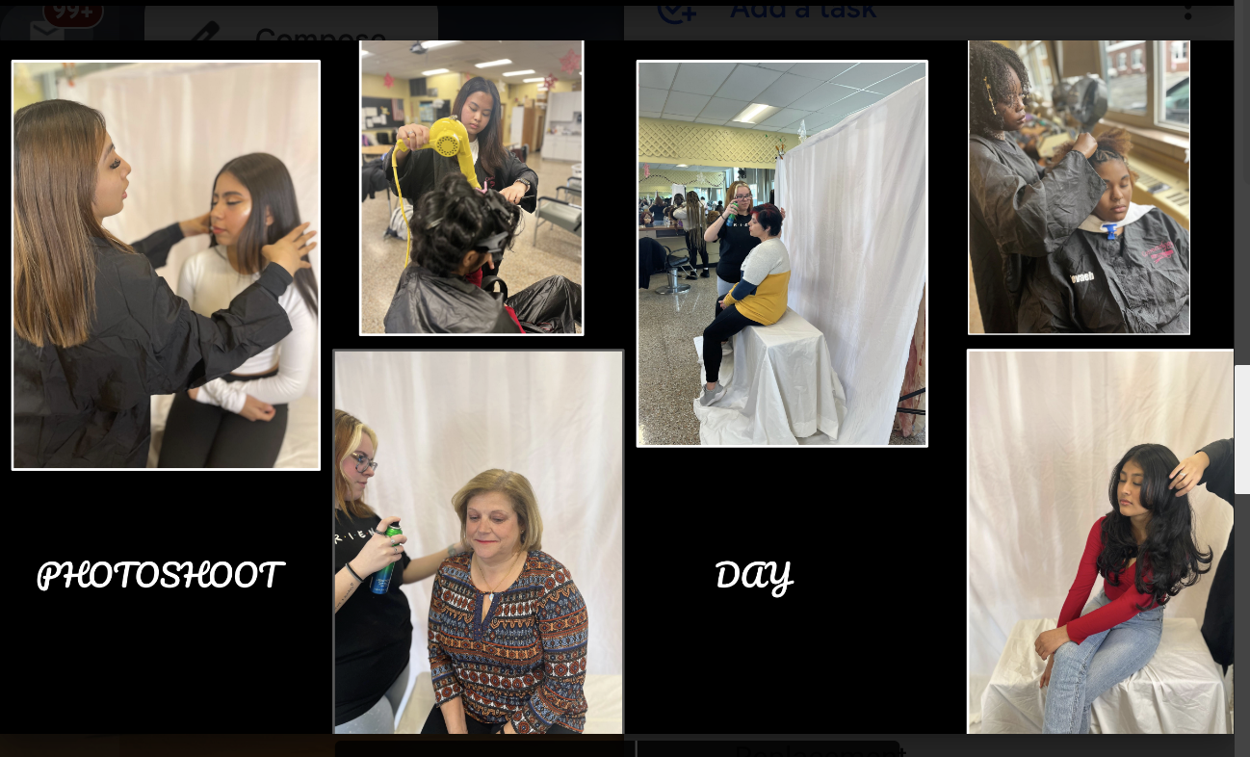
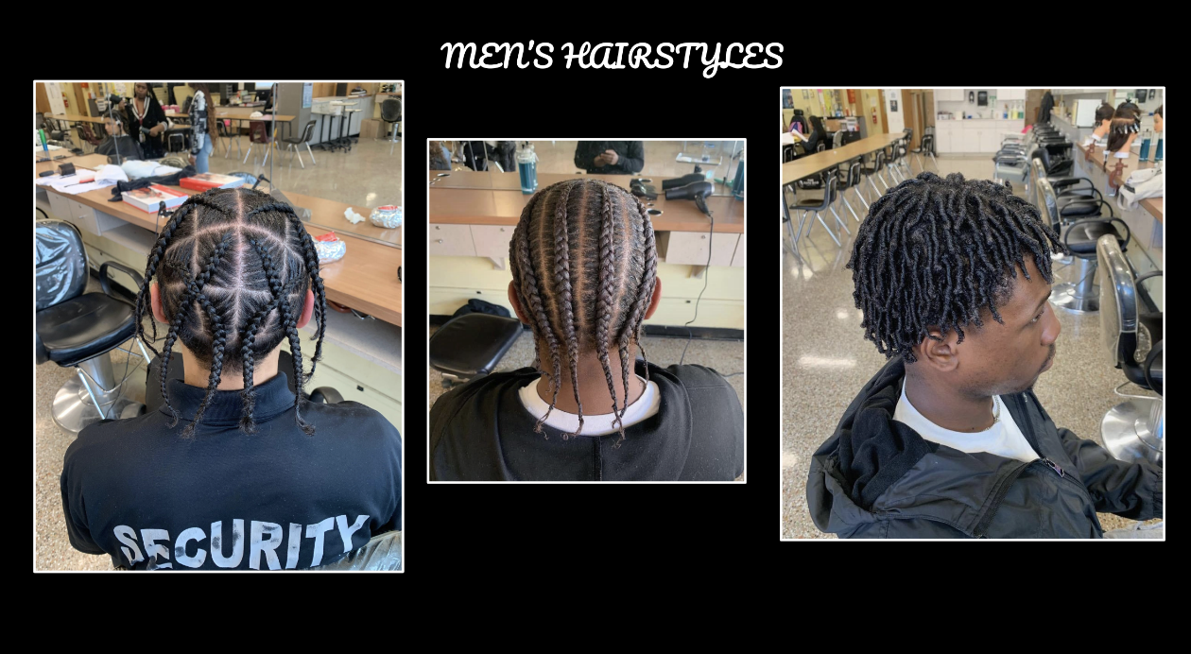

Slide 7
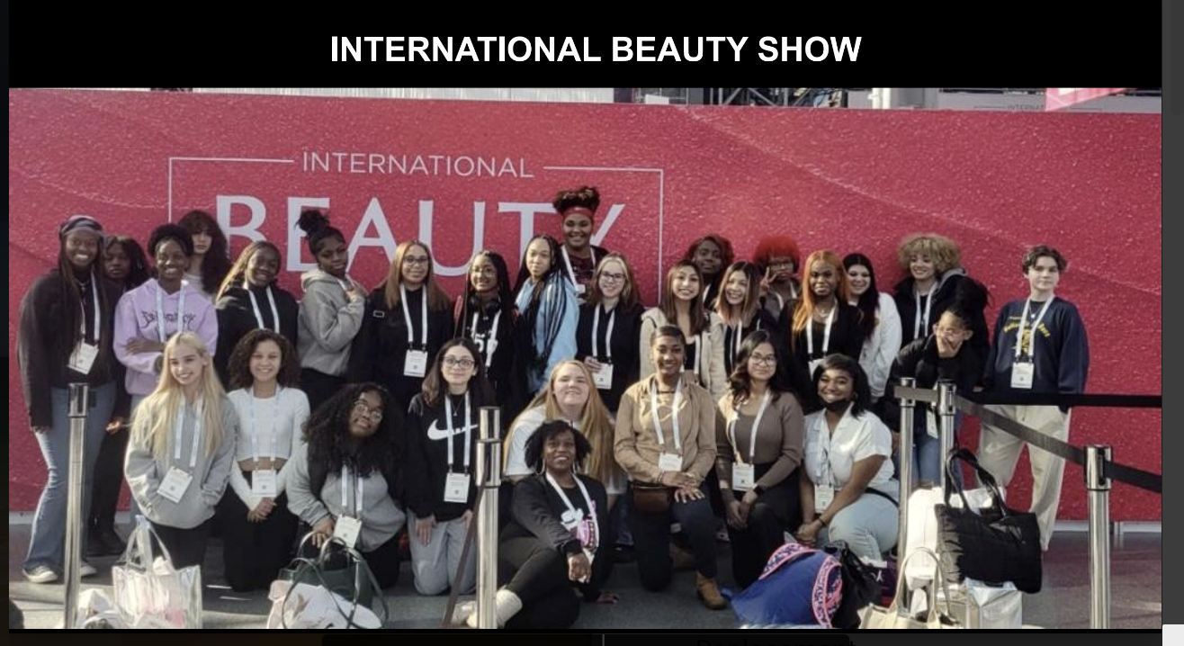
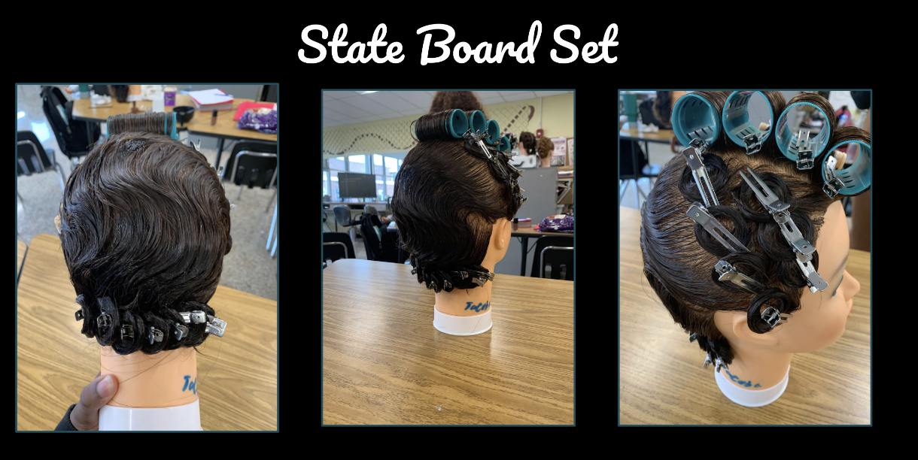
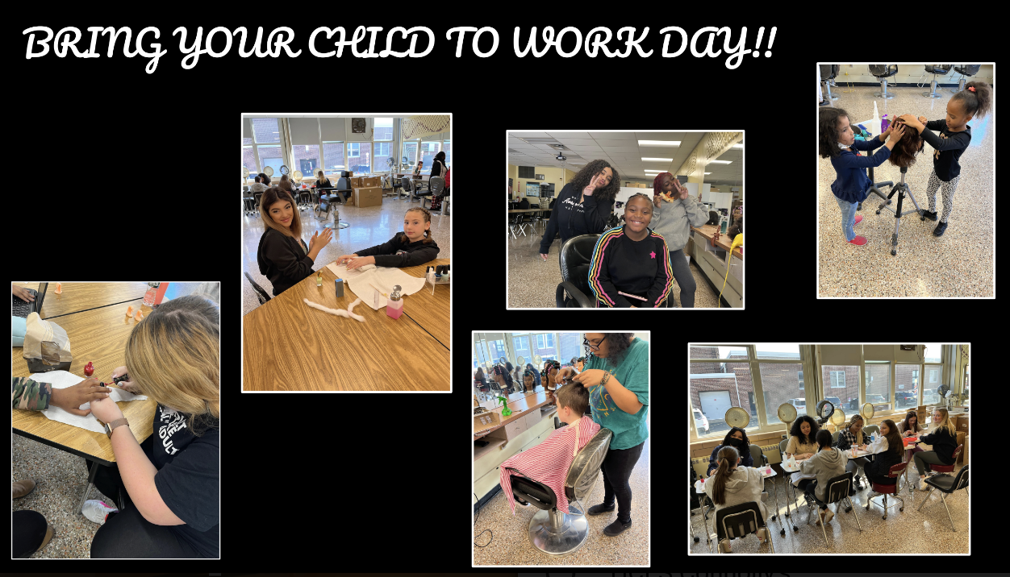

Slide 8
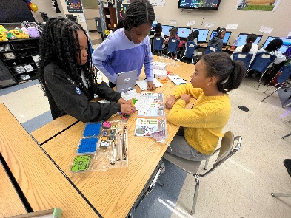
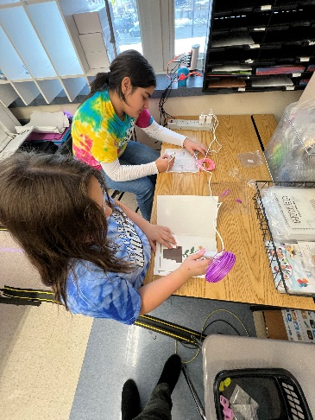
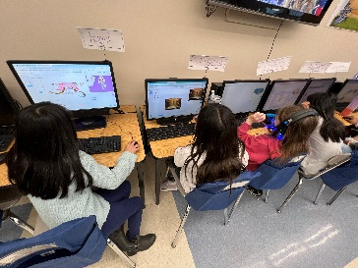
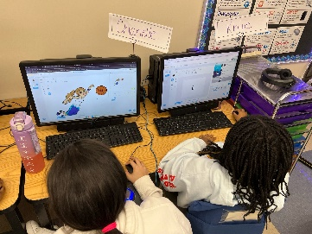
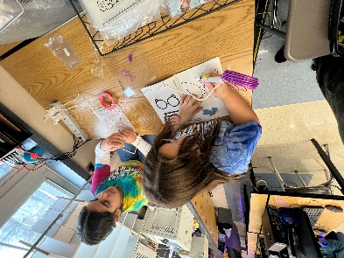
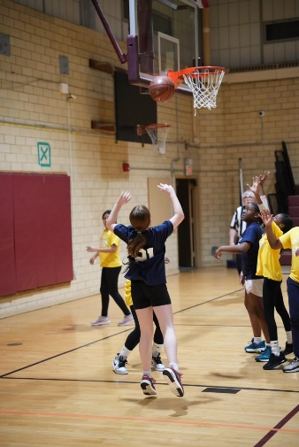
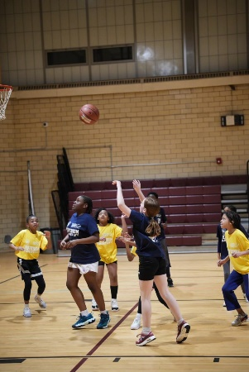
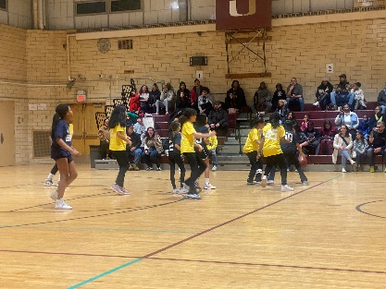
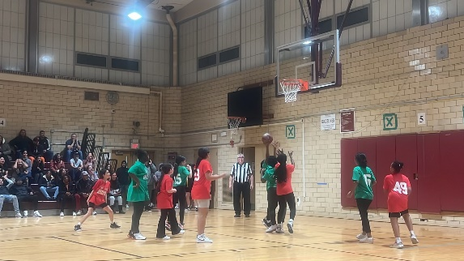
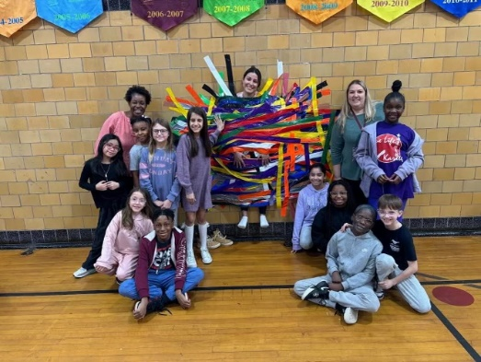
A Small Glimpse
Township of Union Public Schools Mental & Emotional Support Resource Guide
Jefferson Elementary School – Girls Who Code
Girls Who Code is changing the game! Jefferson has an official Girls Who Code after-school program funded through Title I and under the direction of Mrs. Nunes. A total of 27 girls meet weekly to explore coding concepts. They use scratch.org and code.org in the program, allowing students to create digital stories, games, and animations.
In addition, the girls are working with Dash robots, which are full of character and drive around making noises and shining lights. The lessons and activities are aligned with coding concepts, and students learn the basics of robotics and problem-solving skills.
The mission is to close the gender gap in technology and to change the image of what a programmer looks like and does. Girls get to join a sisterhood of supportive peers and role models using computer science to change the world.
Fifth Grade Recreation Basketball Program run by the UTEA
Connecticut Farms Student Council raised funds for the homeless by taping a teacher to the wall.
Connecticut Farms student council raised funds for the homeless by tapping a teacher to the wall. Mrs. Carhart spent 3 1/2 hours taped to the gym wall as the students bought tape to raise money. #WeareproudofU
Advisors: Ms. Katz and Mrs. Carhart

Slide 9
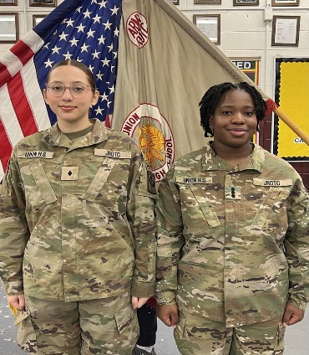
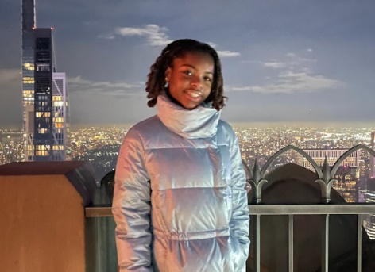
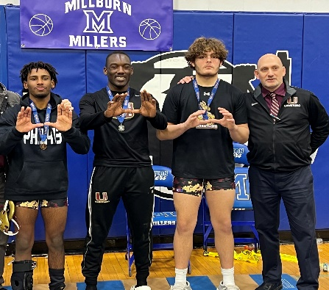
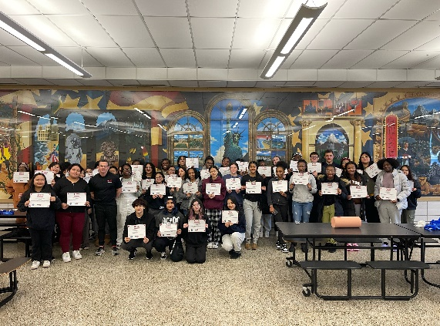
A Small Glimpse
Student Highlights
Joselyn De Salguero & Neissa Filias, both members of the Union High School’s award-winning JROTC program, have been accepted to West Point, which is the fully funded, prestigious four-year academic, physical, and mental education that results in a Bachelor of Science degree and a profession as an officer in the U.S. Army.
Angelina Kearney, made her debut at Carnegie Hall in New York City
Daniel Collin at 175, Nick Bertolotti at 215, & Gabe Hargrove at 126, all advanced to the NJ High School Wrestling Region Qualifiers
Approximately 60 UHS Students came in on their day off to receive Stop the Bleed training

Slide 10
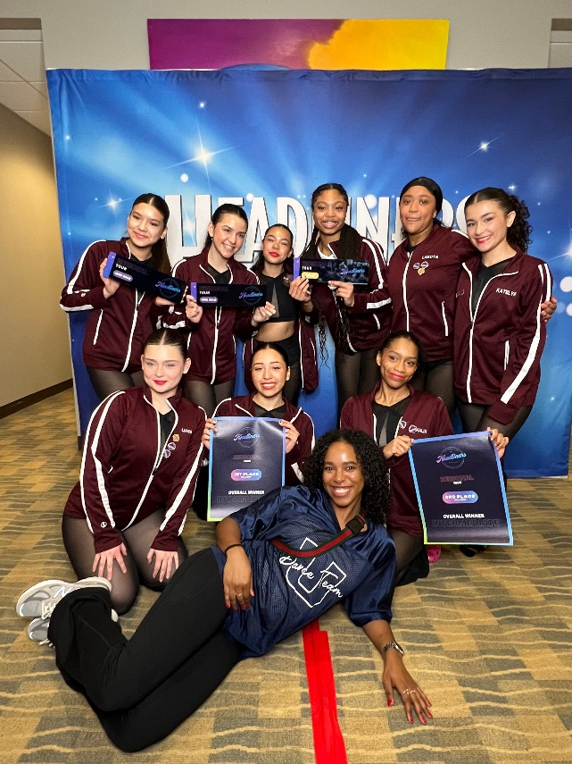
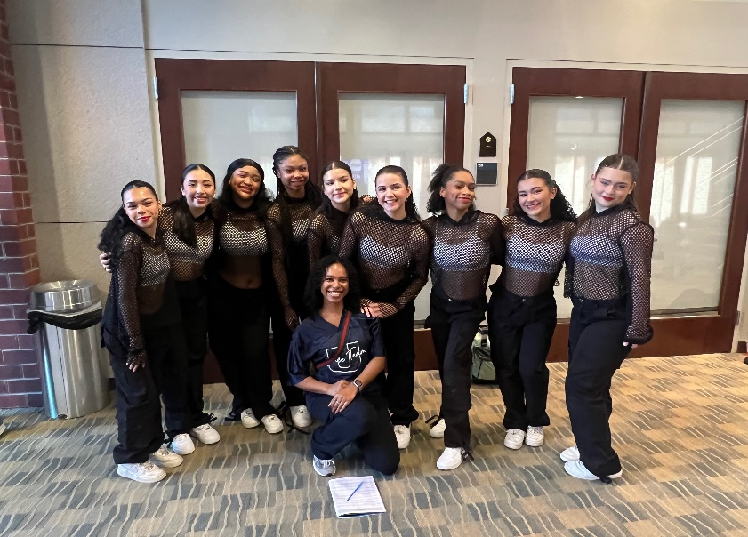
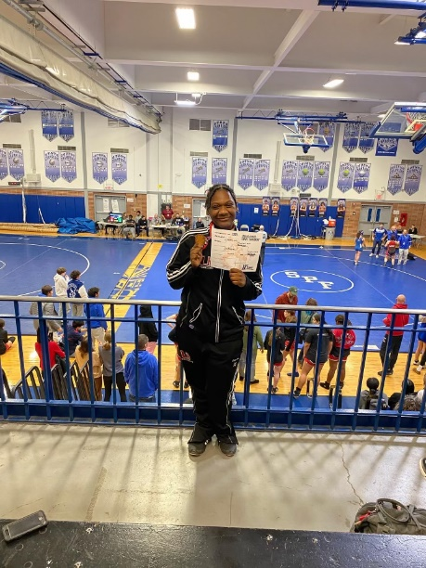
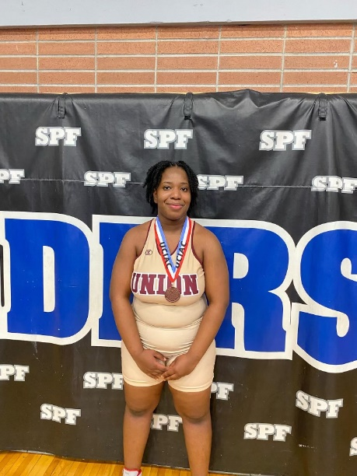
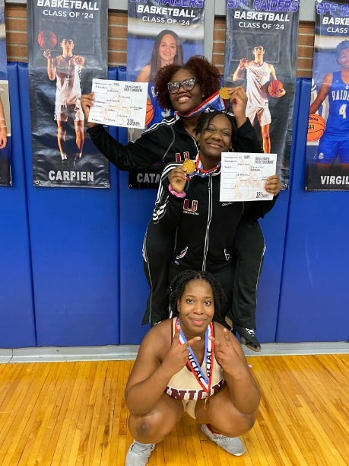
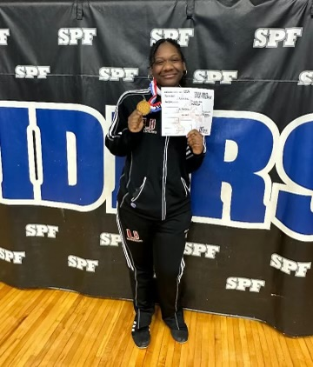
A Small Glimpse
Student Highlights
Ms. Carr & the UHS Dance Team Finished 1st Place
The Union High Dance Team attended their first competition of the season in early February and had a blast. They brought dances that Ashley Carr and guest choreographer Deja McNair choreographed over the past few months. Their hip-hop and jazz dance received a score of high gold, and their contemporary received a score of gold. Their hip-hop placed first overall, and their jazz third overall. For many of these girls, it was their first dance competition that they've been to. This Sunday, they will be attending their second and final competition of the season. Wish them luck!
Girls Wrestling County Champions Alissa Alcindor at 235 Christine Pierre Louis at 185 & 3rd Place Neissa Filias at 235

Slide 11
A Small Glimpse
Black History Month
School | Grade | Subject | Who is engaging in this activity? | Short Description of Activity
DIstrict Wide | PreK |  | All PreK | Teachers will work in their classes individually and the classes will view the other BHM displays. A passort will be completed reflecting the displays each student visited. They must visit one per grade. Students will receive stickers on their passport for each visit. There are special stickers for the passport if they attend one of the township's Black History events.
BHES | K-4 |  | Whole Building | Teachers will work in their classes individually and the classes will view the other BHM displays. A passort will be completed reflecting the displays each student visited. They must visit one per grade. Students will receive stickers on their passport for each visit. There are special stickers for the passport if they attend one of the township's Black History events.
BHES | 3-4 | ART | Ms. Chapman | Ms. Chapman is presenting lessons on Neo-Expressionist Art work inspired by Jean- Michel Basquiat and Javek Steptoe. Her students are producing and displaying art work following the syle of the artists.
CFES | K-4 |  | Whole Building | Black History Month
CFES | K-4 | Music | Zara Fox | Month Long Activities related to African American music
FES | K-4 |  | Whole Building | Daily announcements highlighting prominent African Americans. Laser Lights Black History Assembly. Black HIstory Spirit Week. Black History Author Study.
LES | K-4 |  | Whole Building | Classroom activities, Laser Lights Black History Assembly, Morning announcements highlighting prominent African Americans
LES | K-4 | Music | Michele Koncewicz | Students are studying the music of Africal American Recording artists
LES | 3-4 | Art | Emmanual Cruz | Michele Koncewicz has presented a lesson on the "Tuskeege Airmen". She then worked with those students creating and flying paper airplanes.
WES | 2 |  | Whole Building | Black History Month choice boards-home project. "Famous People in Black History". The powerpoint will teach children about Rosa Parks, Mae Jeminson, Louis Armstrong etc. Students will read books about who they're learning about. Morning quotes virtual libraries posted on google classroom for research and research presentations
WES | 3 |  | Whole Building | Scholastic News on Tuskegee Airmen, Readworks person of the day, BrainPop and BrainPop Jr. videos
WES | 4 |  | Whole Building | Famous black american inventors stories-students will create their own inventions based on "A bus for Rosa Parks", listen to music of Louis Armstrong, listen to poems from Maya Angelou. Research projects and completing pennants to display their work on different influential Black Americans. Multiple STEM projects, such as "Counting on Katherine" focusing on Katherine Johnson and "Whoosh" focusing on Ronnie Johnson, who invented the Super-soaker. Along with those projects, reading comprehension sheets about other Black Americans within the STEM field. We will also be posting a Black History Early Finishers Library to our Google Classroom, so that students can watch and learn about other influential leaders. Students will also have crosswords and word searches to complete for morning work.
WES | K-4 | Art | Sarah Norman | Following a history lesson, er students are creating artwork inspired by Alma Thomos

Slide 12
A Small Glimpse
Black History Month
School | Grade | Subject | Who is engaging in this activity? | Short Description of Activity
JES | 5 |  | Whole Building | Google Slide presentation for Black History Month connected to Epic so they can read and listen to grade-level stories about civil rights heroes and different famous Black History Leaders. School counselor has this posted - Black History Month Daily Inspiration and many classrooms are completing individual projects
JES | 5 | Social Studies | JES Social Studies Teachers | From "We are Teachers." 55 Black History Month Videos Teachers share videos with students throughout the month.
JES | 5 | Art | Mr. Toscano | Mr. Toscano has prented a lesson on Faith Ringgold, a popular African American Artist and activist. All of his art students are then creating Art work which is similar in style to Ms. Reinggold's "Story Quilts".
BMS | 6-8 |  | Whole Building | LMC display and presentation. Honors US History project and culminating Black History Museum.
BMS | 6-8 | Social Studies | BMS Social Studies Teachers | From "We are Teachers." 55 Black History Month Videos Teachers share videos with students throughout the month.
BMS | 6 | Social Studies | BMS Social Studies Teachers | Rosa Parks Timeline & Word Search
BMS | 6 | Social Studies | BMS Social Studies Teachers | Rosa Parks Quests
BMS | 7 | Social Studies | BMS Social Studies Teachers | Black History Month Project
BMS | 8 | Social Studies | BMS Social Studies Teachers | Black History Month Tissue Box Project
BMS | 6-8 | Music | Terron Singletary | Month Long Activities related to African American music
KMS | 6-8 |  | whole building | RSR- Video shown of reading of Book - "Let the Children March" by Monica Clark-Robinson - Run contest afterwards to win the book read. English classes Analyze Poetry in the context of Black history to gain a deeper understanding of diverse voices and experiences. Bulletin displays throughout the school. Playing the video of Amanda Gorman reciting her poem at the Presedential Election-discussion of what it meant-the how and the why she wrote the words she did. Explore a variety of children's books such as "The Other Side" by Jacqueline Woodson and "Change Sings" by Amanda Gorman to discuss theme and content.
KMS | 6-8 | Media Center | whole building | Library Media Center presentation and books to support Black History month. School wide video read aloud with School Librarian during Ready, Set, Read from "Let the Children March" by Monica Clark-Robinson.
KMS | 6-8 | Social Studies | KMS Social Studies Teachers | From "We are Teachers." 55 Black History Month Videos Teachers share videos with students throughout the month.
KMS | 6 | Social Studies | KMS Social Studies Teachers | Black History Month Mini-Research Project
KMS | 7 | Social Studies | KMS Social Studies Teachers | Black History Month Activity
KMS | 7 | Social Studies | KMS Social Studies Teachers | Daily do now activities pertaining to Black History Month
KMS | 8 | Social Studies | KMS Social Studies Teachers | On going spotlight and celebration/recognition of famous African Americans and their achievements.
KMS | 6-8 | Art | Jill Rible | Ms. Rible has been presenting lessons on Social Change and popular African American Artists. Students are also creating art related to her lessons. Ms. rible will also be presenting student artwork which will be displayed at the Black History Month Art exhibit which will be held at the Vauxhall Library on 2/16.

Slide 13
A Small Glimpse
Black History Month
School | Grade | Subject | Who is engaging in this activity? | Short Description of Activity
UHS | 9-12 |  | whole building | Roots: Black Excellence Club morning announcements with person of the day and BHM themed music selection over the PA. Student at random are interviewed each day to respond to the quesiton, What is Black History Month to you?; UHS Library BMH Info via 'X'
UHS | 9-12 |  | whole building | Morning announcements
UHS | 9-12 | Social Studies | UHS Social Studies Teachers | From "We are Teachers." 55 Black History Month Videos Teachers share videos with students throughout the month.
UHS | 9 | World History | one teacher | Rosa Parks Timeline
UHS | 9 | World History | UHS Social Studies Teachers | Mae Jemison Reading
UHS | 10 | US History | one teacher | Black History Month-Periodic Table
UHS | 11 | US History | UHS Social Studies Teachers | African American History Presentations
UHS | 11 | US History | one teacher | Black History Month Project
UHS | 11 | US History | one teacher | https://edpuzzle.com/assignments/65c0d559d7c0f413bcce5ae5/watch?authuser=0
UHS | 11 | US History | one teacher | Joe Louis Documentary & Assigned Questions
UHS | 11-12 | Psychology | one teacher | Black History in Psychology
UHS | 9-12 | Art | Art Teachers | Teachers are presenting work by famous African American artists. Students are then creating work reflecting their styles and displaying the work as well.
UHS | 9-12 | Art | Esquivel | Ms. Connell, HS Fashion Design teacher has been presenting famous African American Designers and their prolific fashion designs. Those students are then creating renderings of their designs that mirror that of the professionals. Those drawing have been displayed in the HS.
UHS | 10-12 | Art | Connell | Diane Esquivel Has been researching Successful African American Artists or Movements. Students are then creating related Art work.
UHS | 9-12 | Music | Melissa Hannon | Teacher introduceds the History and discography of Billie Holiday. The Show Choir is performing her piece entitled "Ill Be Seeing You.

Slide 14
Harassment, Intimidation, and Bullying (HIB)
January 24, 2024 - February 13, 2024
Affirmed
 | Founded | Unfounded | Inconclusive
January 24, 2024, to February 13, 2024 | 2 | 0 | 0

Slide 15
Harassment, Intimidation, and Bullying (HIB)
January 24, 2024 - February 13, 2024
Affirmed
 | Founded | Unfounded | Inconclusive
Battle Hill Elementary
Burnet Middle | 1
Connecticut Farms Elementary
Franklin Elementary
Hannah Caldwell Elementary
 | Founded | Unfounded | Inconclusive
Jefferson Elementary
Kawameeh Middle
Livingston Elementary
Washington Elementary
Union High | 1

Slide 16
Harassment, Intimidation, and Bullying (HIB)
February 13, 2024 - February 20, 2024
Reported
 | Founded | Unfounded | Inconclusive
February 13, 2024, to February 20, 2024 | 7 | 0 | 1

Slide 17
Harassment, Intimidation, and Bullying (HIB)
February 13, 2024 - February 20, 2024
Reported
 | Founded | Unfounded | Inconclusive
Battle Hill Elementary
Burnet Middle | 3
Connecticut Farms Elementary
Franklin Elementary
Hannah Caldwell Elementary
 | Founded | Unfounded | Inconclusive
Jefferson Elementary | 1
Kawameeh Middle | 2
Livingston Elementary
Washington Elementary
Union High | 1 |  | 1

Slide 18
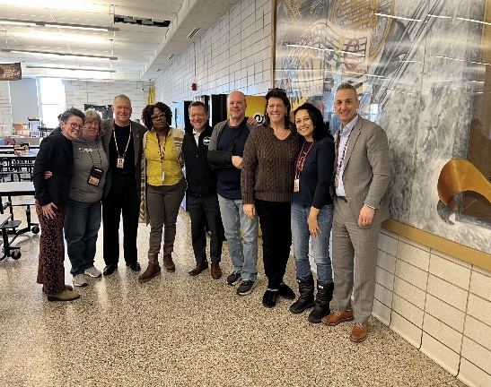
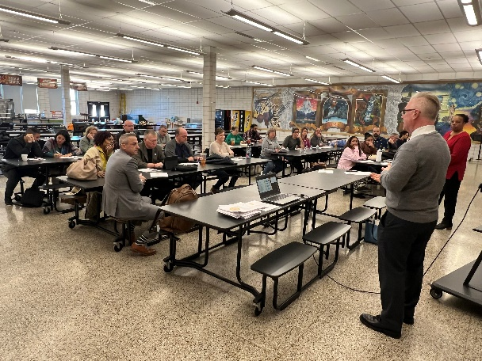
A LOOK FORWARD
2023-2024 TUPS Teacher(s) of the Year
This past Friday, February 16, 2024, Township of Union Board Members, Central Office Leadership, Principals & Supervisor Leadership & UTEA Leadership all embarked on professional development in Labor-Management Collaboration. As a collaborative unit, we will take part in continuing our journey on March 4, 2024, at NJPSA.
NJ Labor-Management Collaborative includes NJEA, NJSBA, NJASA, and NJPSA
📢 Attention TUPS Parents of students in grades 3-12! 📚 Join us for a Parent Night Info Session about our fantastic FREE online tutoring service, PearDeck Tutoring (formerly Tutor Me), on February 22nd at 6:00 pm. Discover more about this opportunity to support your child's learning and foster their growth. Join via ZOOM and enter the Meeting ID: 944 2566 9187. We hope to see you there! For questions, email Coordinators Alison Brehm at abrehm@twpunionschools.org abrehm@twpunionschools.org and Danielle Stabler at dstabler@twpunionschools.org dstabler@twpunionschools.org

Slide 19
TUPS Student Liaisons
Neissa Filias
&
Gia Patel
https://docs.google.com/presentation/d/1ZPKxu87dovJiUN-tI7baethcWC78NVkwLdWplzNoNFM/edit?usp=sharing

Slide 20
Thank You
TUPS Community

