Slide 1
Superintendent’s Report State of the Schools November 21, 2023

Slide 2
Impact Employee Recognition
Carnegie Hall
Farmer’s Café
UCEA ESP of the Year!
HOPE
Student Farmer Frontline: What’s up with TUPS!
Visionary Leadership Mentorship Academy: Empowering Leaders for Success!
A Small Glimpse
HIB Report for October 11th to November 21st Affirmed
HIB Report for November 15th to November 21st Reported
Student Liaisons – Neissa Filias & Gia Patel

Slide 3
IMPACT EMPLOYEE RECOGNITION
I am beginning the Township of Union Public Schools "Impact Teacher" Program, which aims to acknowledge administrators, educators, and staff members who, through their actions, dedication, and achievements, have profoundly influenced the lives of our students.

Slide 4
2024 High School Honors Performance Series at Carnegie Hall
Program Highlights
Perform in one of two elite Honors Performances at Carnegie Hall under the direction of renowned conductors.
Work with master conductors and build your performing resume.
Rehearse and interact with other Finalists from across the globe.
Commemorate your accomplishments and have fun with your new friends at the Finalist Celebration.
Attend a Broadway Show, visit New York’s most famous landmarks, like Times Square, and experience the Big Apple!
Angelina Kearney
Senior
Has received to date (26) A+ (4) A and (2) A-
Rigorous class schedule at Union High School
Angelina is the president of the Roots: Black Excellence Club
Angelina has been a Girl Scout for 12 years
Angelina had two plays she has written, performed in New York by professional actors.
Angelina was a part of the Theater Development Fund’s Young Playwrights program

Slide 5
FARMER’S CAFE
Lauren Kohn
People to recognize: Kim Conti for supporting my vision and providing us with start-up materials. Ms. Bossard for allowing me the opportunity to open the cafe at the high school.
My cafe adult staff: Corey Baker (para), Elyse Toglia (speech), Kim Matta (teacher), Jill Mincolelli (para), Janiya Mozee (para), Barbara Johnson (para), Keyla Puerto (para), Huda Dwekat (para) all assist the students in the cafe. They are essentially the students' job coaches.
How did the cafe get started?
After attending training, completing research, and visiting other schools, my goal has always been to bring our program to the next level. Each year, I aim to bring a new opportunity for self-contained students/students with disabilities. We must provide students with the necessary tools to assist with success outside of high school. Statistics show that 80% of adults with disabilities are unemployed or underemployed. The café was started so I could provide an authentic work-based learning site to students with disabilities. My hopes are to connect and build partnerships with local businesses and our community now and in the future, ultimately giving young adults with disabilities local job opportunities. The café will provide these real-life opportunities to gain the necessary vocational skills, social skills, self-confidence, and independence. It will also help develop interpersonal skills that are necessary to succeed in any work environment. This also helps them connect with the general education students, as I have been striving for our school to be a more inclusive environment. The café has jobs for all abilities. I aim to help students with disabilities lead fulfilling lives within the community and for everyone to see their potential. The café is a place for everyone; all students and staff are welcome and can purchase hand-made beverages and baked goods.
December 19, 2023, There will be an official ribbon cutting, and the Farmer’s Café will be Honorary Members of the Greater Union Township Chamber of Commerce.

Slide 6
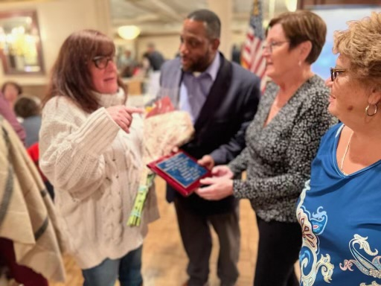
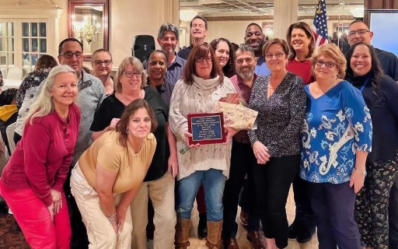
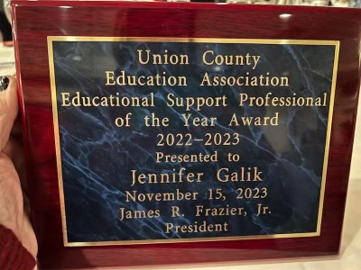
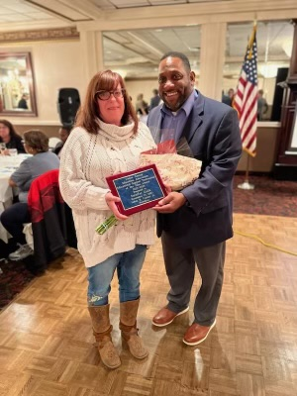
Union County Education Association UCEA
Jen Galik
2022-2023 Union County is the Educational Support Professional ESP of the Year!
Education Support Professionals play crucial roles both within and beyond the classroom. They contribute to the smooth operation of schools, prioritizing students' safety, health, and preparedness for effective learning.

Slide 7
HOPE
Hispanic Organization for Peoples Empowerment
Patricia Guerra-Frazier
Assist. Superintendent of curriculum, instruction, and assessment
Dr. Gretel Perez
Our amazing education advocates/warriors on the Board of Education:
Dicxiana Carbonell
Chastity Santana
Yocasta Brens-Watson
https://docs.google.com/presentation/d/1WHZUP9G9Yet0D2eVzpVuvQ2iuFxFznmlFrZRRJx58bs/edit?usp=drivesdk

Slide 8
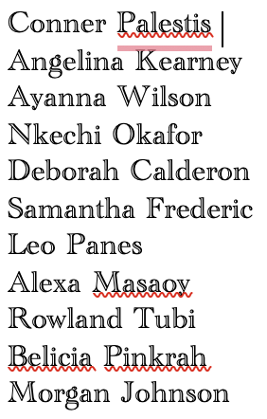
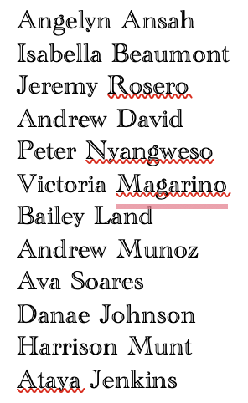
Student Farmer Frontline
What's up with TUPS?
A team of passionate individuals to share positive news stories about the Township of Union Public Schools.
Promote Positivity Hone Your Skills
Make a Difference Build Lasting Friendships
Our Goal is to have our first Newsletter completed at the end of this month or early December!

Slide 9
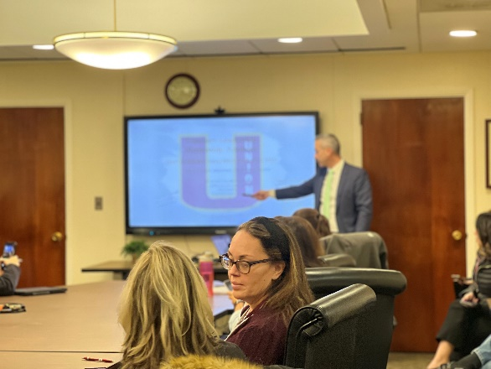
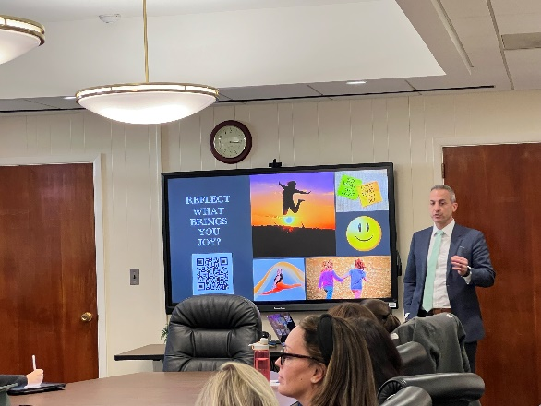
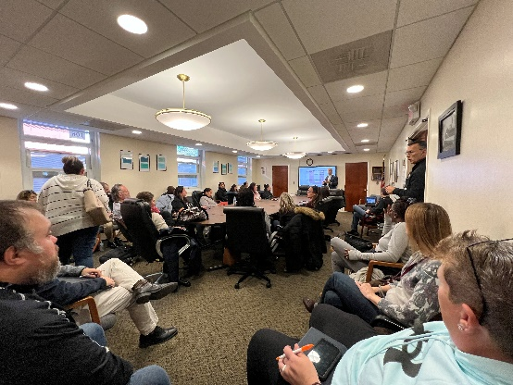
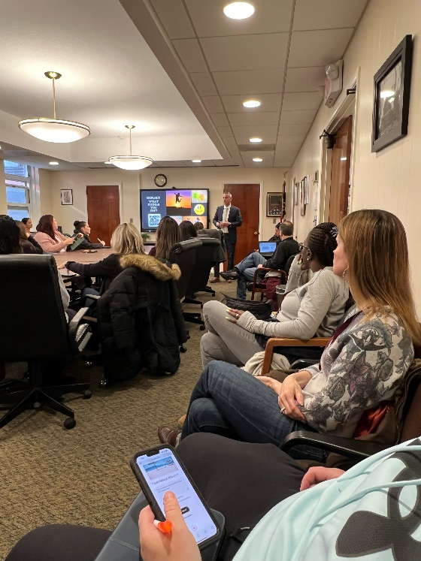
Visionary Leadership
Mentorship Academy
EMPOWERING LEADERS FOR SUCCESS!
Had our first meeting yesterday
What is a mentoring Academy?
Reflection
What does research say about mentoring programs
Ralph Nader said, “The function of leadership is to produce other leaders, not just other followers.”
Growth Leadership & Grit
Schedule of Meetings
December 18, 2023
January 22, 2024
February 12, 2024
March 18, 2024
April 15, 2024
May 20, 2023
June 10, 2023
51 Signed up & 31 Attended
The courage of leadership is giving others the chance to succeed even though you bear the responsibility for getting things done. SIMON SINEK

Slide 10
Union High School Program Highlights
A SMALL GLIMPSE
Dual Enrollment Programs (UHS)
Kean Scholar Academy, 9 students (12 credits per year)
Tomorrow's Teachers, 8 students (Into to Education Course credit from Kean)
Spanish, Project Acceleration, 4 students (Seton Hall)
College Courses
Fall 2023, Kean Comm 1402 course, 14 students
Spring 2024 Kean Comm 1402 course, 11 students
Eng 101, UC College Readiness Program, Spring 2024 (at UHS), still pending, potential 9 students
Courses at UC through the Bridge Program and the UC Grant, 2 students
Spring 2024 with UC still pending based on funds
Summer 2023 Summer at UC, their grant-funded, 17 students
Other Curriculum Highlights
Cosmetology has a state license option
CAD 4 exam
Advanced Placement Courses
22 AP courses
415 students enrolled
673 exams being taken (some students taking more than 1)

Slide 11
Harassment, Intimidation, and Bullying (HIB)
 | October 11, 2023 - November 21, 2023
 | AFFIRMED
 | Founded | Unfounded | Inconclusive
October 11, 2023, to October 17, 2023 | 5 | 0 | 4
October 18, 2023, to November 14, 2023 | 5 | 1 | 1
November 15, 2023, to November 21, 2023 | 12 | 11 | 8

Slide 12
Harassment, Intimidation, and Bullying (HIB)
October 11, 2023 - November 21, 2023
Affirmed
 | Founded | Unfounded | Inconclusive
Battle Hill Elementary |  | 1
Burnet Middle | 5
Connecticut Farms Elementary | 3
Franklin Elementary | 1 | 5
Hannah Caldwell Elementary
 | Founded | Unfounded | Inconclusive
Jefferson Elementary | 1 | 1 | 1
Kawameeh Middle | 3 |  | 2
Livingston Elementary |  | 2
Washington Elementary
Union High | 10 | 3 | 9

Slide 13
Harassment, Intimidation, and Bullying (HIB)
 | November 15, 2023 - November 21, 2023
 | REPORTED
 | Founded | Unfounded | Inconclusive
November 15, 2023, to November 21, 2023 | 6 | 1 | 2

Slide 14
Harassment, Intimidation, and Bullying (HIB)
November 15, 2023 - November 21, 2023
Reported
 | Founded | Unfounded | Inconclusive
Battle Hill Elementary
Burnet Middle | 4
Connecticut Farms Elementary | 1
Franklin Elementary
Hannah Caldwell Elementary
 | Founded | Unfounded | Inconclusive
Jefferson Elementary
Kawameeh Middle
Livingston Elementary
Washington Elementary |  |  | 1
Union High | 1 | 1 | 1

Slide 15
TUPS Student Liaisons
Neissa Filias
&
Gia Patel
https://docs.google.com/presentation/d/1xIA3mbDhNIf9Jf3VCZw2tVtyBeB7Zcl6_vNgKqIftq4/edit?usp=sharing

Slide 16
Thank You TUPS Community
& Happy Thanksgiving!

