Slide 1
2022-23
Assessment Summary Results
Township of Union Public Schools
September 2023

Slide 2
A summary of the district’s data
NJSLA proficiency results and subgroup analysis
NJGPA results and subgroup analysis
ACCESS for MLLs performance data
DLM performance data
Our response to the data
2022-23
Assessment Summary Results

Slide 3
Township of Union
Assessment Summary
Noticings and Trends

Slide 4
Noticings and Trends
New Jersey Student Learning Assessments (NJSLA) proficiency percentages increased from 2021-2022 to 2022-2023 in:
  ELA (Grades 4, 5, 7, 9)
  Math (Grade 4, Grade 5, Grade 6, Algebra I, Geometry)
  Science (Grades 5, 8)
NJSLA total test takers in ELA - 3812 (98%)
NJSLA total test takers in Math - 3846 (89%)
New Jersey Graduation Proficiency Assessment (NJGPA) proficiency percentages increased from 2021-2022 to 2022-2023 in both ELA and Math, with ELA increasing 45% over the previous year.
Despite these increases, we recognize that there is still a lot of room for growth - particularly in math and science.
In all subjects on both the NJSLA and NJGPA, our Multi-lingual Learners (MLLs) and Special Education students continue to have the lowest levels of proficiency.
In most subjects and grades, our growth year-over-year is comparable to that of the state overall.
Notes:
*NJGPA is administered to students in grade 11 for the purpose of meeting the state graduation assessment requirement.

Slide 5
NJ Student Learning Assessment (NJSLA)
ELA - Grades 3-9
Math - Grades 3-Geo

Slide 6
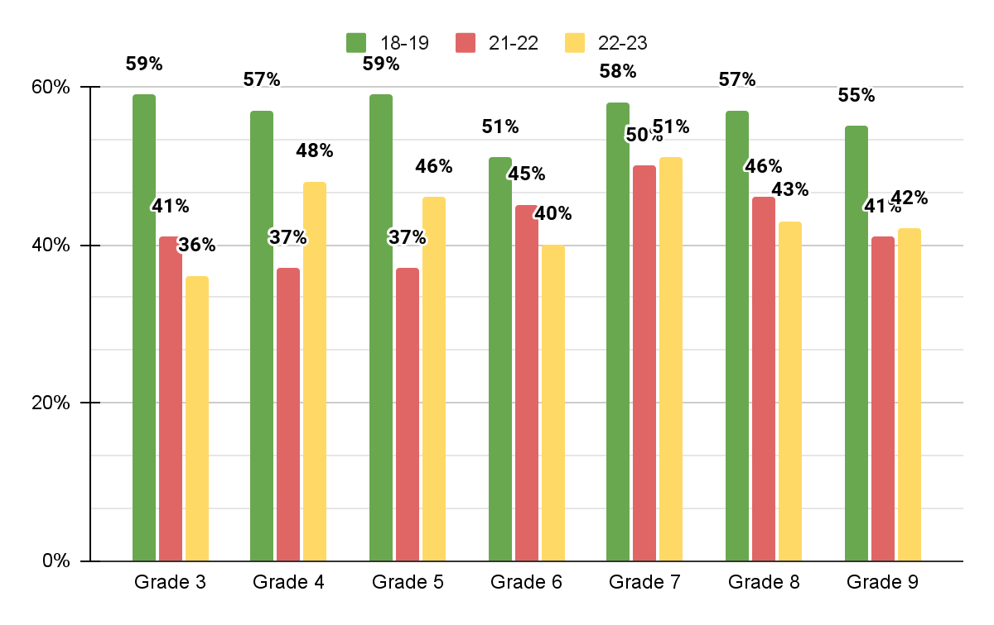
TOWNSHIP OF UNION
Spring NJSLA Trend Data
ELA Proficiency (Scores of 4 & 5)

Slide 7
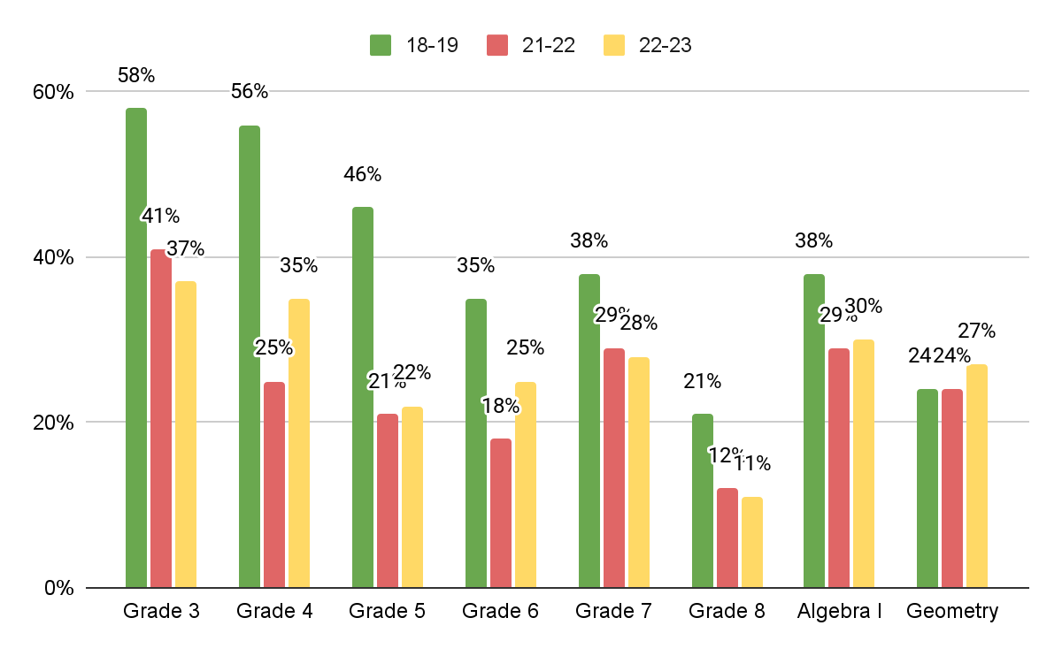
TOWNSHIP OF UNION
Spring NJSLA Trend Data
MATHEMATICS Proficiency (Scores of 4 & 5)

Slide 8
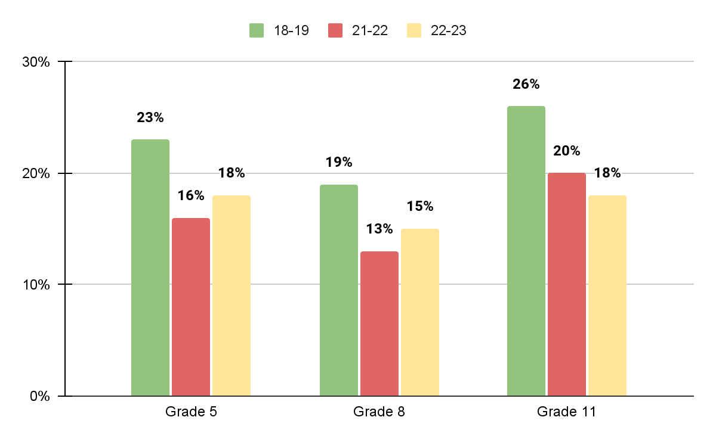
TOWNSHIP OF UNION
Spring NJSLA Trend Data
Science Proficiency (Scores of 4 & 5)

Slide 9
NJ Student Learning Assessment (NJSLA)
Subgroup Data

Slide 10
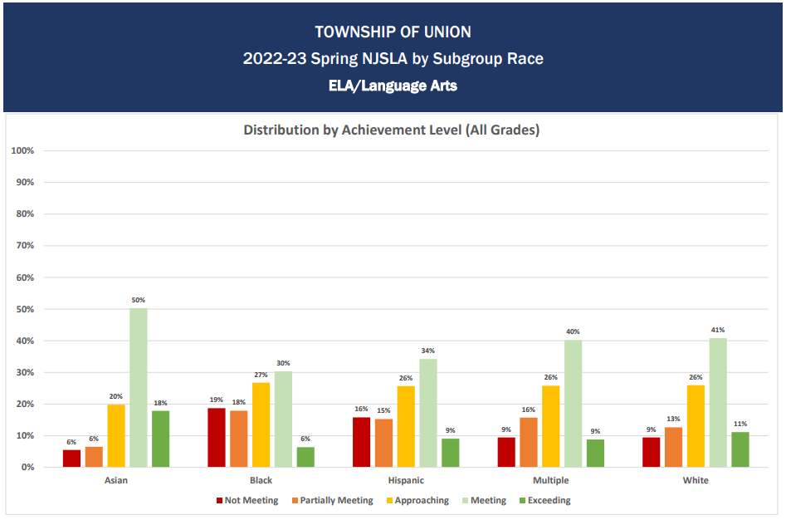
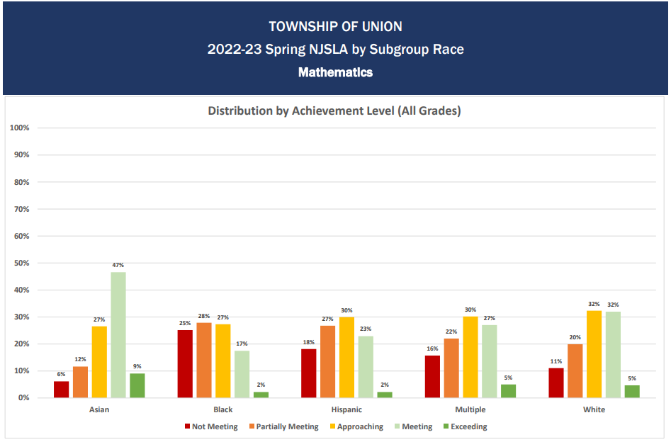
ELA
MATHEMATICS
NJSLA

Slide 11
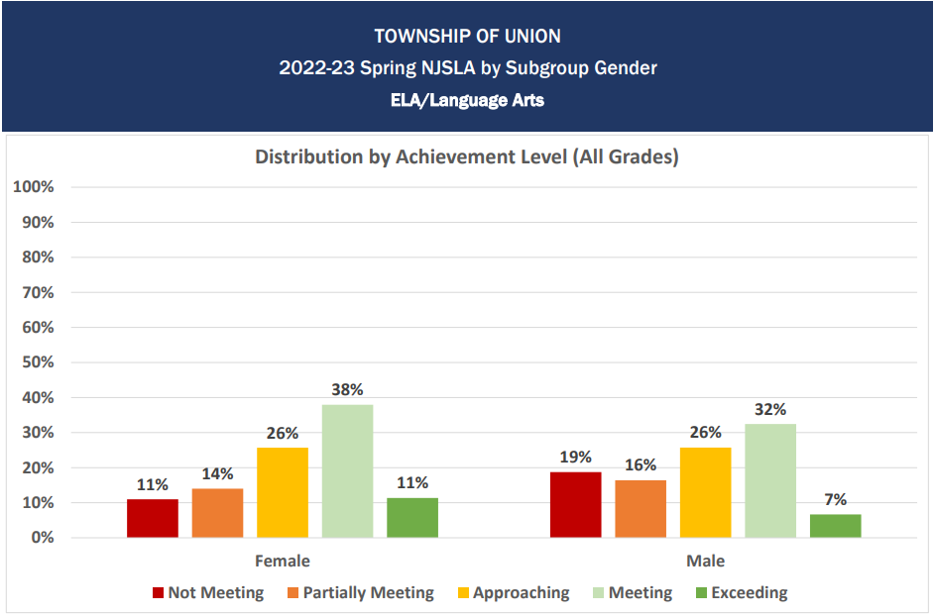
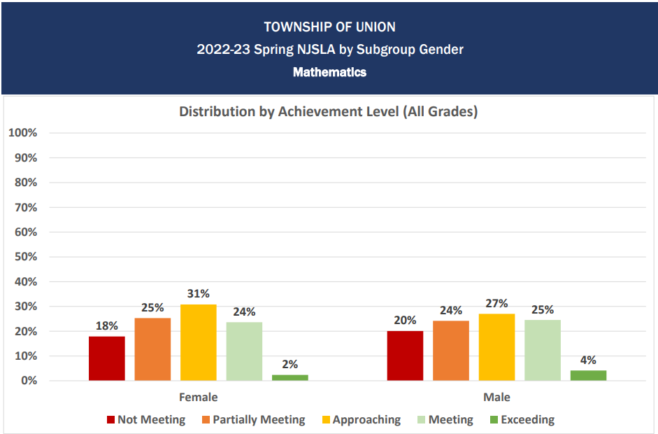
ELA
MATHEMATICS
NJSLA

Slide 12
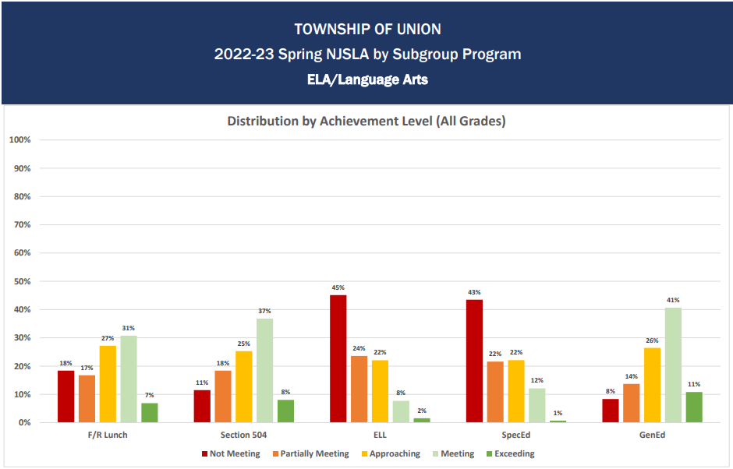
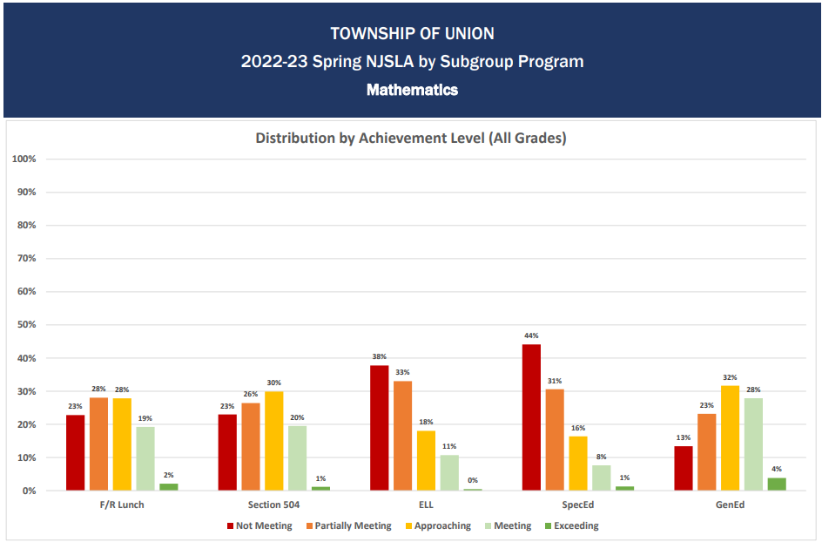
ELA
MATHEMATICS
NJSLA

Slide 13
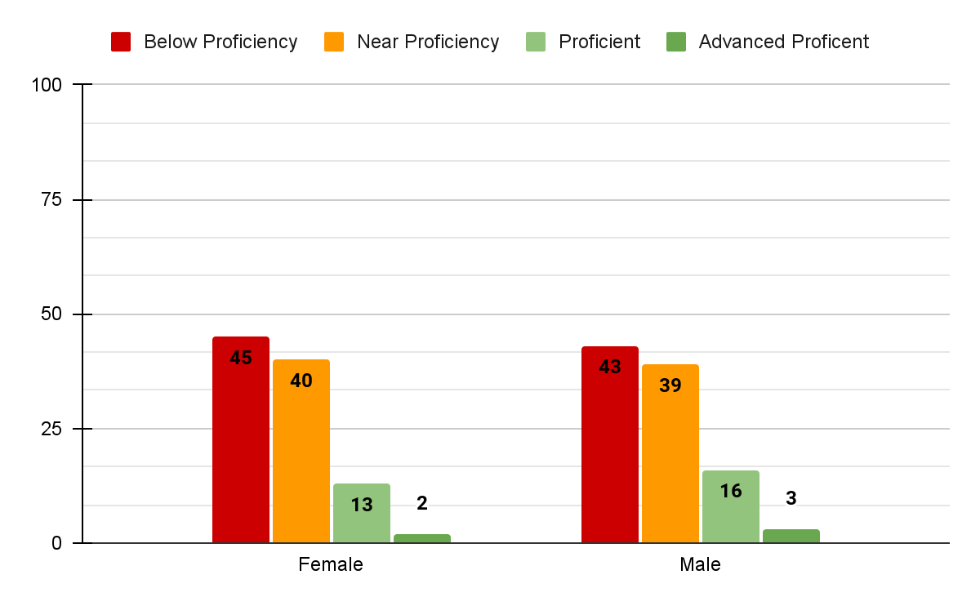
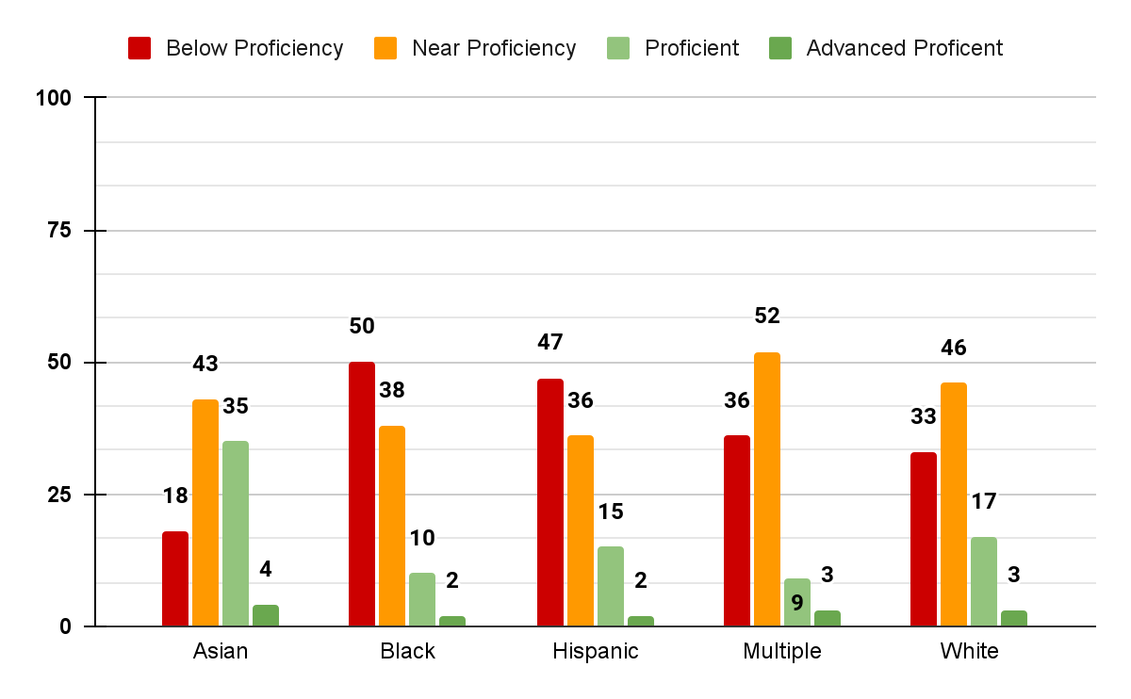
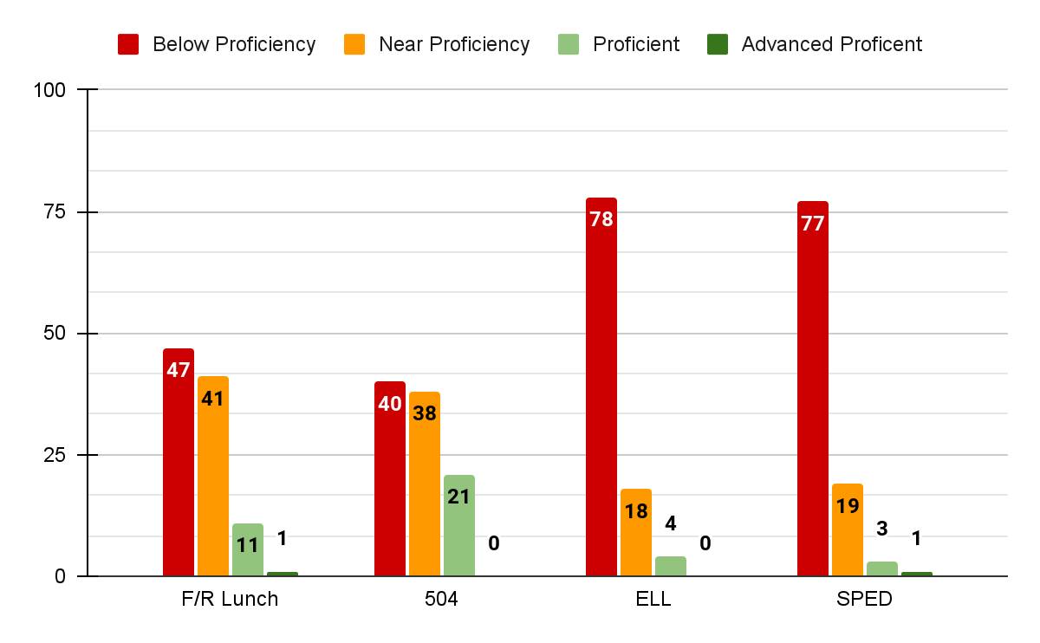
TOWNSHIP OF UNION
2022-23 Spring NJSLA by Subgroup
Science
NJSLA

Slide 14
NJ Graduation Proficiency Assessment (NJGPA)
Grade 11 - ELA & Math

Slide 15
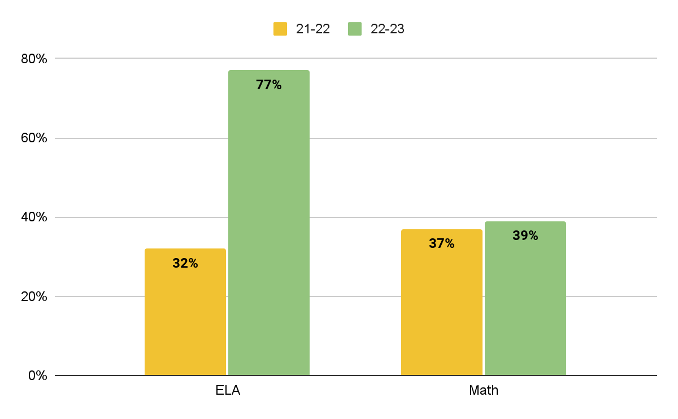
TOWNSHIP OF UNION
Spring NJGPA Trend Data
ELA/MATH - Graduation Ready

Slide 16
NJ Graduation Proficiency Assessment (NJGPA)
Subgroup Data

Slide 17
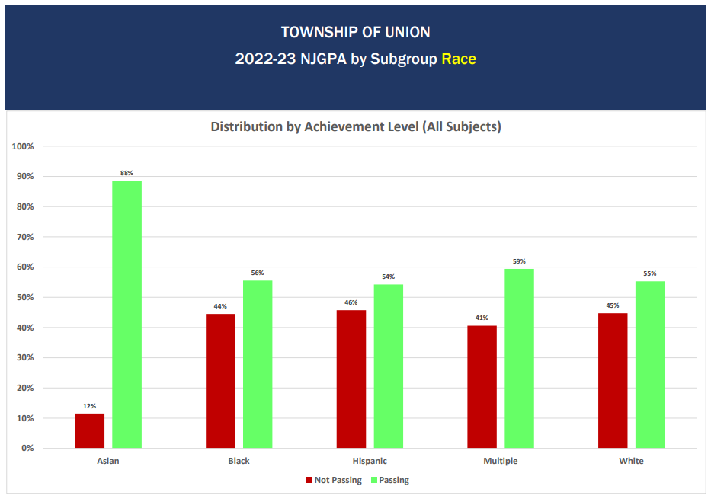
NJGPA

Slide 18
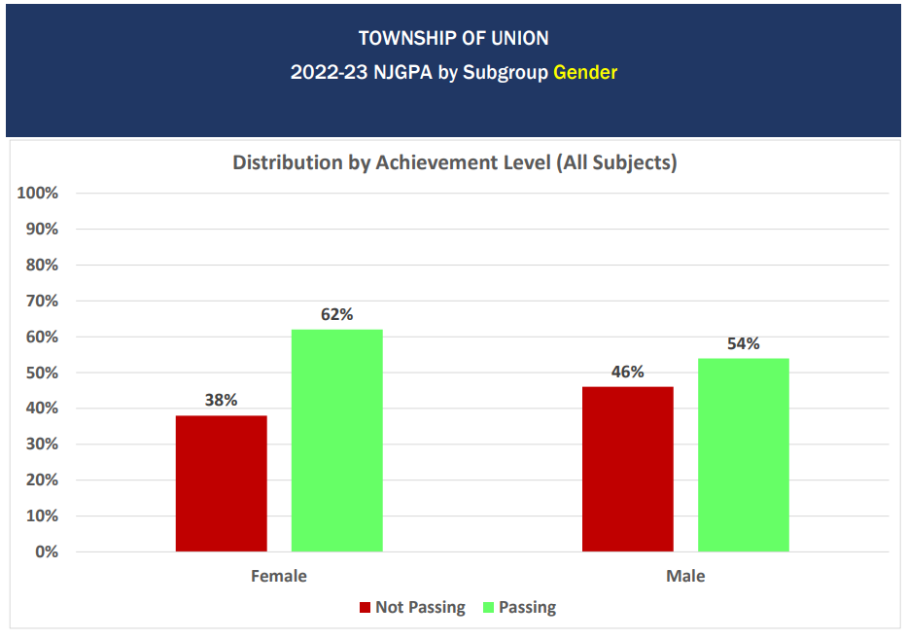

Slide 19
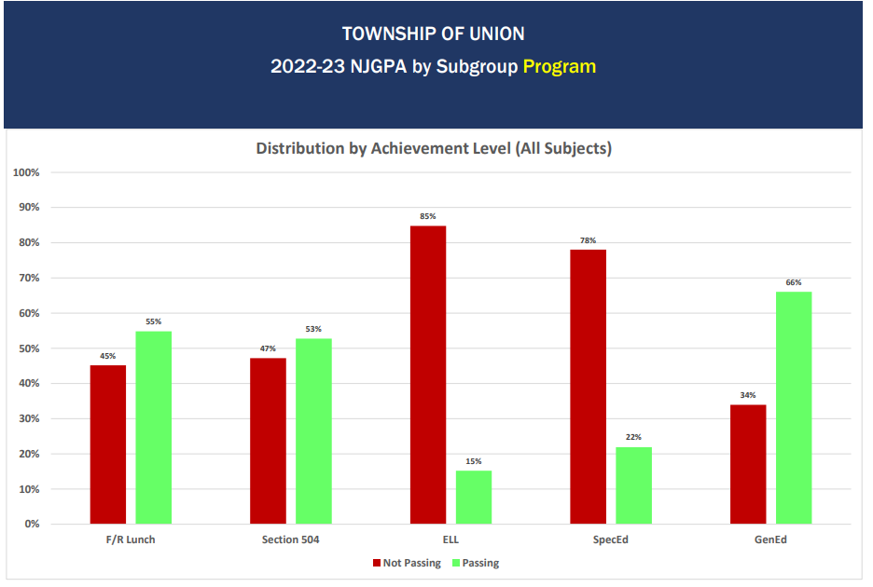
NJGPA

Slide 20
ACCESS for MLLs

Slide 21
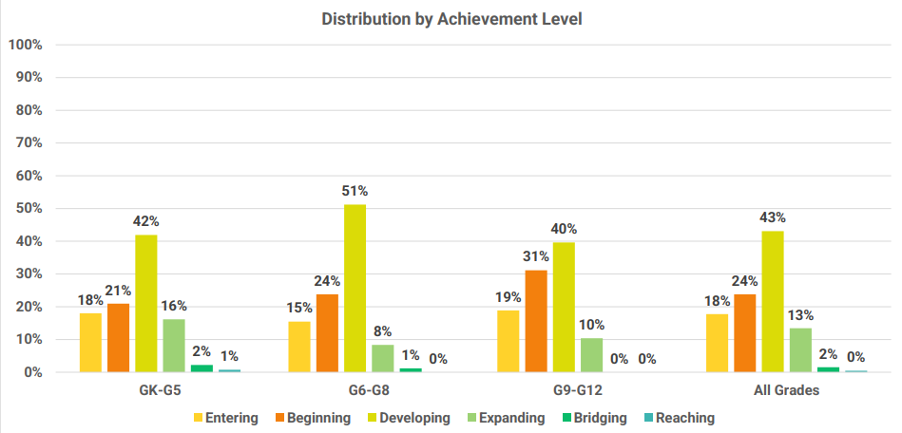
TOWNSHIP OF UNION
2022-23 Spring
ACCESS
MLLs in grades K-12 take the WIDA ACCESS for MLLs in the Spring. Scores are reported in to proficiency level and scale scores for all four language domains: Reading, Writing, Speaking, and Listening. Proficiency level scores describe performance based on six levels.

Slide 22
Dynamic Learning Map (DLM)

Slide 23
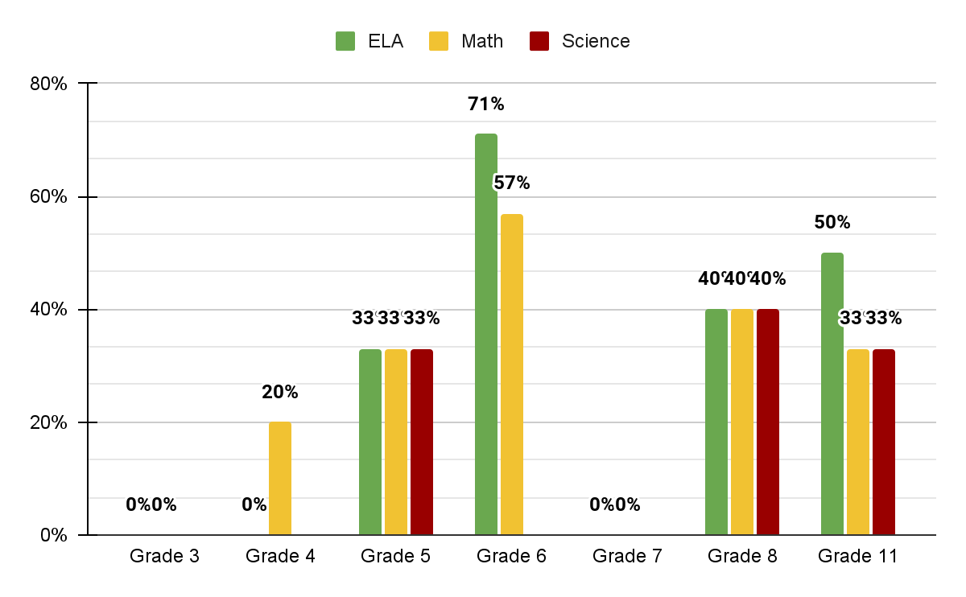
TOWNSHIP OF UNION
2022-23 Spring
DLM
The New Jersey Alternate Assessment (NJAA) is the Dynamic Learning Maps (DLM) and it is an assessment of English Language Arts, mathematics, and science skills aligned to the New Jersey Standards for eligible students with significant intellectual disabilities in grades 3-8, and 11.
Emerging | Approaching | At Target | Advanced

Slide 24
Next Steps and Interventions

Slide 25
How can we continue to learn from our data?
a focus on data usage and analysis
Administrators will be working with PLCs to help them better access, analyze, and use available district, school, and classroom data.
We are continuing to build on our utilization of LinkIt to help analyze and communicate data, especially through use of the “fingertip reports” (sample on next slide).
We are encouraging staff to use the summarized evidence statement reports to inform their SGOs.
We are encouraging staff, departments, and buildings to work collaboratively on SGOs, planning, and assessment.
We will be monitoring student learning using benchmarks in the fall, winter, and spring to help us target instruction based on areas of need.
Buildings/Grades | Subject Areas | Program
Elementary & Jefferson | ELA & Math | i-Ready Diagnostics
BMS & KMS | ELA and Math (6-8), Science (8 only) | IXL Diagnostics (ELA, Math) LinkIt Benchmarks (Sci)
UHS | ELA & Math | LinkIt Benchmarks

Slide 26
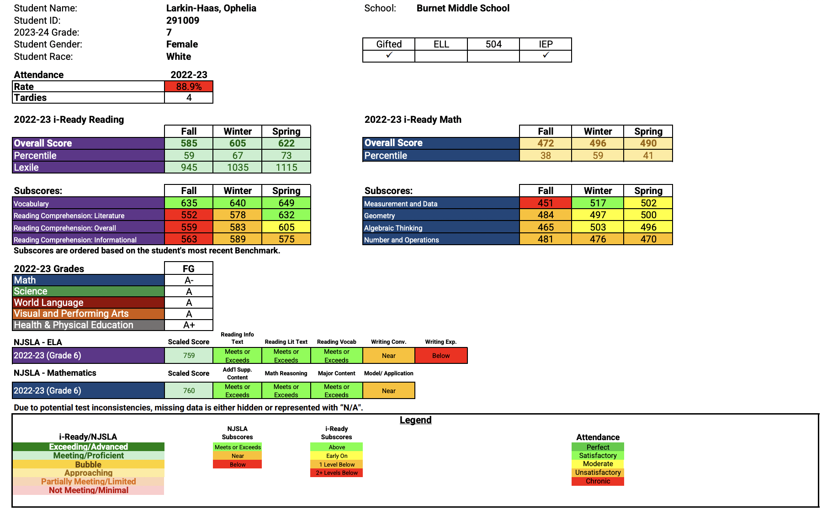

Slide 27
How do we increase achievement?
a focus quality academic practices to increase achievement
Common PLC times have been established K-12 to support cross-building collaboration.
We are focusing our PD on high effect instructional strategies and content-specific practices.
We will focus on developing a better understanding of math fluency in K-8.
We will focus on explicit phonics instruction (science of reading) in K-2.
We are piloting ELA programs rooted in SOR in K-5 ELA with a goal of September 2024 adoption.
We will provide teachers with training on developing assessments that require reasoning, analysis, and application.
This year, we have adopted of a K-2 science program that focuses on scientific and engineering practices.
We plan to rewrite K-8 science curriculum.
We will provide science staff with specific PD focused on using the science and engineering practices to explain scientific phenomena.
We will provide elementary staff with PD focused on better understanding science and math content.
We are using the WIDA Fingertip Reports to help differentiate for MLL students based on their language readiness and “can-do’s” (sample next slide)
Notes:
k-2 Into Science (HMH)

Slide 28
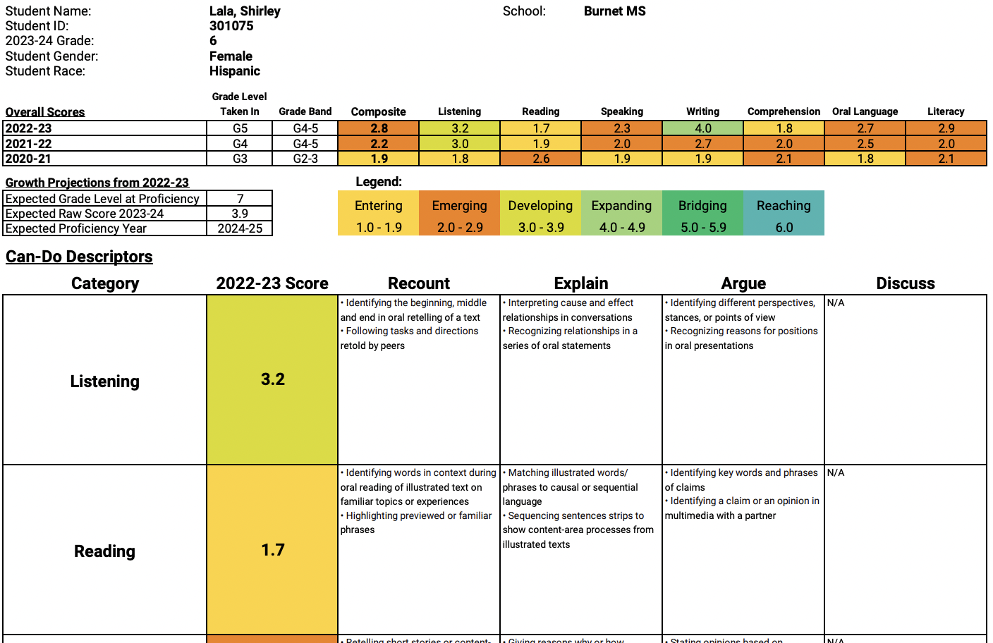

Slide 29
How do we support our students who are struggling?
a focus on intervention and support
There are a number of ways that we are providing specific support for students, including but not limited to:
Intervention periods are now built into the K-4 school schedule in every elementary school every day and administrators will be working with staff to leverage that time effectively.
We will work to better utilize our resources to differentiate instruction for students in classrooms and during interventions.
We intend to participate in the upcoming RAPID Learning Acceleration Professional Development Program when it is released.
We are participating in the New Jersey High Impact Tutoring program to focus on students in grades 3-4, however we will also be able to bring tutoring options to all students in grades 3-12.
We are providing targeted instruction in phonics for Special Education students.
We will be working to reevaluate and make changes to our I&RS process.
We are awaiting the finalized draft of the Special Services audit and, upon receipt, we will be looking to see what actions we need to take.

Slide 30
Thank you!

